Slide 1
Effective Collaboration in Fraud Prevention
Utilizing Internal and External Partnerships to Combat Fraud and Abuse
Tim Helms, MHSc, LDO

Slide 2
Medicaid Program Integrity (MPI)
Investigate providers suspected of fraud or abuse
Assist providers with self-audits
Recover overpayments by conducting audits
Issue administrative sanctions
Refer “credible allegations of fraud” to law enforcement
Assess risks of Medicaid program vulnerabilities

Slide 3
Chief
Prevention
Detection
Operational Support
Overpayment Recoupment
Field Operations (Miami)
Field Operations (JOT)
Prevention Strategy
Managed Care Oversight & Compliance
Rx and DME
Practitioners
Institutional
Investigations
Reporting Compliance
Anti-Fraud & Compliance Plan
Data Analytics
Intake
Generalized Analysis

Slide 4
Prevention Strategy Unit Responsibilities
Provide analytical support to the field operations
Prioritize on-site provider reviews
Coordinating unit with the Division of Medicaid
Combat fraud through provider enrollment, policy, and training
Coordinating unit with Health Quality Assurance (HQA)
Combat fraud in provider types licensed by the Agency for Health Care Administration (AHCA)
Developing and implementing a strategic plan for MPI
Conduct organizational and functional assessment reviews of bureau operations

Slide 5
Referrals Section Responsibilities
Conduct investigations of providers suspected of fraudulent or abusive behavior.
Identify and develop referrals to the Medicaid Fraud Control Unit (MFCU).
Conduct Pre-Payment Reviews (PPR) of providers.
Identify potential referrals to:
Health plans
Division of Medicaid
Division of HQA
Department of Health – Medical Quality Assurance
Other law enforcement and/or regulatory agencies

Slide 6
Administrative Section Responsibilities
Impose payment restrictions pursuant to law:
Credible Allegations of Fraud (CAF)
Reliable Evidence of Fraud (25a)
Pre-Payment Reviews (PPR)
Impose sanctions pursuant to law and rule:
Fines
Suspension from Program Participation
Termination from the Program – For Cause

Slide 7
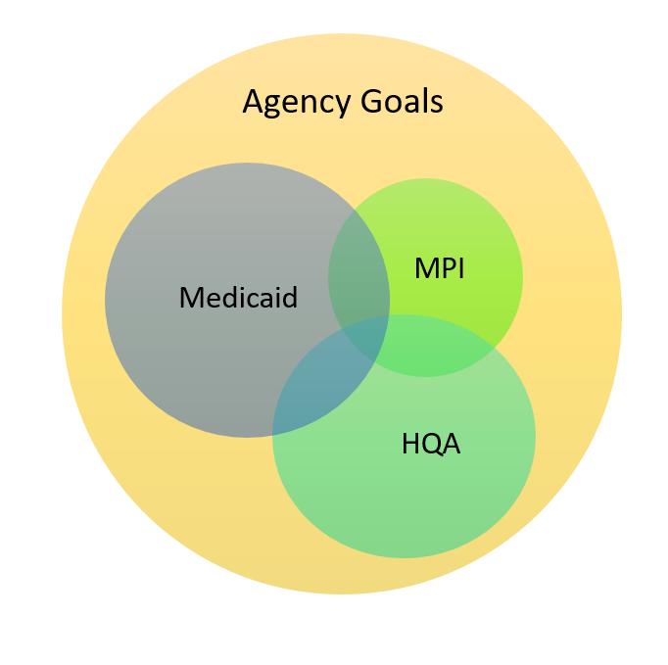

Slide 8
We Cannot Succeed Alone
Magnitude of the program
Broad program integrity issues
Limitations on staffing resources
Limitations on other resources
Scope of authority

Slide 9
External Partnerships
Centers for Medicare and Medicaid Services (CMS)
Law enforcement/Medicaid Fraud Control Unit
Federal contractors
Other state agencies
Managed care plans
Provider associations
Other states

Slide 10
Effective External Partnerships
CMS State Liaison
CMS MIC/ZPIC/UPIC
MPI/MFCU referral staffing meetings
Florida Inter-Agency Fraud meetings
Managed Care Plan Quarterly Fraud meetings

Slide 11
Internal Partnerships
Division of Medicaid
Medicaid program operations, policy, quality, etc.
Medicaid Program Integrity
Prevention
Detection
Recovery / Recoupment
Health Quality Assurance
licensure and regulatory activities

Slide 12
Effective Internal Partnerships
Fraud Steering Committee & Subcommittees
Prevention & Provider Enrollment
Detection
Managed Care
HQA Weekly Facility Action Meetings
Payment Restriction Impact Reviews
Pre-Payment Review (PPR) Notices
Best Interest Determination Process
Facility Closure Protocol

Slide 13
Legal Provisions
Federal Anti-Kickback Statute
Florida Patient Brokering Statutes
Federal Physician Self-Referral Prohibition
Stark Law
Florida Patient Self-Referral Act
Safe harbors and exceptions
Federal Civil False Claims Act
Payment restrictions
Notes:
Slide about PPRs and other payment restrictions -- sanctions

Slide 14
Federal Anti-Kickback Statute
42 U.S.C. § 1320a-7b(b)
Prohibits soliciting, receiving, offering, or paying anything of value to encourage or reward referrals or to generate business from federal health care programs
Penalties may include:
fines up to $25,000 per violation
prison term up to 5 years
federal health care program exclusion
civil monetary penalties up to $50,000 per scheme
Notes:
Case examples

Slide 15
Florida Patient Brokering Statutes
Section 456.054, F.S. (Kick-backs)
Applies to all Florida health care providers and any provider of health care services
Prohibits offering, paying, soliciting, or receiving a kickback for referring or soliciting patients
Section 817.505, F.S. (Patient Brokering)
Applies to any person
Prohibits offering, paying, soliciting, or receiving a commission, bonus, rebate, kickback, or bribe, or engaging in any split-fee arrangement to induce or reward referrals, or to aid, abet, advise, or otherwise participate in this prohibited conduct

Slide 16
Stark Law
42 U.S.C. § 1395nn
Prohibits:
physicians from referring Medicare and Medicaid patients for designated health services to any entity with which the physician or an immediate family member has a financial relationship
the entity providing the designated health service from submitting claims to a federal health care program, or billing an individual or third-party payor for services resulting from a prohibited referral
Penalties may include:
refunds of overpayments
civil monetary penalties
up to $15,000 per violation and $100,000 per scheme
federal health care program exclusion

Slide 17
Florida Patient Self-Referral Act
Section 456.053, F.S.
Very similar to the federal Stark Law
Key Differences:
Only applies to investment interests, not employment or independent contractor relationships
All health care services are subject to provisions, not just designated health services
Applies to referrals for services reimbursed by all private and governmental payors

Slide 18
Safe Harbors
Investment interests in large entities
group practices, ambulatory surgical centers, small entities
Space and equipment rental
Sale of a practice
Referrals services
Warranties
Statutory exceptions analogous to safe harbors
Electronic health records and other information systems
Joint ventures
Nursing home arrangements with hospices

Slide 19
The Differences
Anti-Kickback Statute
Stark Law
Violations are criminal
Referrals from anyone prohibited for remuneration
Referrals prohibited for all types of items or services
Intent must be knowingly and willfully
Applies to all federal health care programs
Safe harbors are voluntary
Violations are civil
Referrals from physicians prohibited for remuneration
Referrals prohibited for designated health services
No intent required for overpayments (only for civil monetary penalties)
Applies to Medicare and Medicaid only
Exceptions are mandatory

Slide 20
Federal Civil False Claims Act
31 U.S.C. § 3729-3733
Prohibits:
knowingly presenting, or causing to be presented, a false or fraudulent claim for payment
knowingly making, using, or causing to be made or used, a false record or statement material to a false record or claim
conspiring to commit a violation of this section
Penalties may include:
civil penalties between $5,500 and $11,000 per claim
treble damages

Slide 21
Sanctions
Fines
Submitting materially false information on provider application
Failure to comply with overpayment repayment agreement
Failure to comply with MPI or MFCU records demand
Suspension
All three issues cited above
DOH or HQA license suspension
Charged by information or indictment with disqualifying offense
Termination
DOH or HQA license revocation or denied renewal
Convicted of or pleaded guilty to disqualifying offense
Medicare revocation or other state Medicaid termination

Slide 22
“CAF” Payment Suspension
42 C.F.R § 455.23
Suspension of payments in cases of fraud
Legal standard: credible allegations
Requires referral to MFCU
May not be invoked if good cause exists to not suspend payments:
Law enforcement request
Best interest of the Medicaid program

Slide 23
Medicaid Payment Withhold
Section 409.913(25)(a), F.S.
Withholding of payments in circumstances of:
fraud
willful misrepresentation
abuse
a crime committed while rendering goods or services to Medicaid recipients
Legal standard: reliable evidence
Invoked at discretion of the Agency

Slide 24
Pre-Payment Review (PPR)
Section 409.913(3), F.S.
PPR of provider claims and documentation to ensure appropriate billing by the provider
Legal standard: as determined appropriate by AHCA
without need for suspicion of fraud, abuse, or neglect
May last up to one year
Claims adjudicated within 90 days after receipt of complete documentation
extended to 180 days with reliable evidence of fraud, abuse, misrepresentation, or neglect

Slide 25
MFCU Referrals
Legal mandates for referrals to MFCU
409.913(4), F.S.
Refer ALL cases of suspected criminal violation
42 CFR 455.21(a)(1)
Refer ALL cases of suspected provider fraud
42 CFR 455.23
Refer ALL credible allegations of fraud
Must conform to minimum criteria set by CMS:
Acceptable Referral Performance Standard, Oct. 2008
Best Practices Interactions with MFCU, Sep. 2008

Slide 26
MFCU Referrals Criteria
12 elements of minimum criteria for referral:
Subject name, Medicaid ID, address, provider type
Source or origination of complaint
Date reported to State
Description of suspected misconduct, with specific details
Category of services
Factual explanation of the allegation
Specific laws, statutes, rules, or policies violated
Dates of conduct
Amount paid during previous 3 years or period of misconduct
All communications between State and provider
Contact info for State agency staff with practical knowledge
Exposed dollar amount

Slide 27
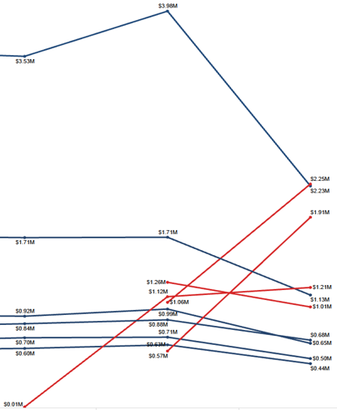
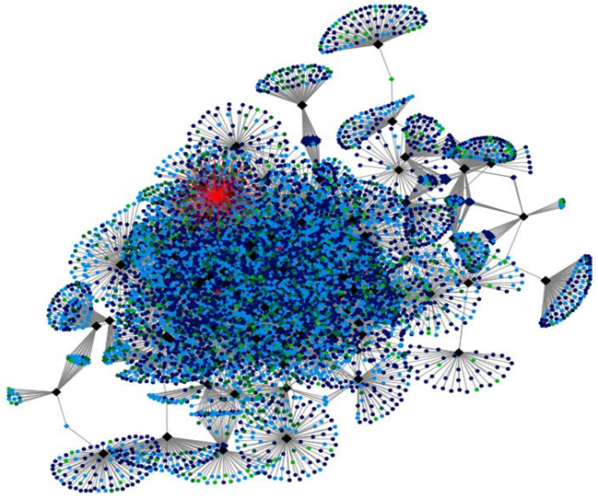
Case Updates
Fraud in the News
Current Trends
Recent Investigations

Slide 28
Additional Resources
Agency for Health Care Administration Web page: contains information about Florida Medicaid, facility licensure, and information abut the quality of health care in Florida.
Florida Medicaid web page: contains program information for providers and the public, including resources such as provider handbooks, fee schedules, and recent Medicaid presentations and reports.
Florida Medicaid also has created an e-mail alert system to supplement the present method of receiving Provider Alerts information and to alert registered subscribers of "late-breaking" health care information.
FloridaHealthFinder.gov is a repository of consumer health care information.
AHCA OIG page (with MPI information) includes links to the Agency’s annual report on the State’s Efforts to Control Fraud and Abuse, a link for on-line reporting of suspected fraud as well as additional resources about fraud and abuse.
Also from this page, or the Agency’s public record page, you can search for all Medicaid sanctioned providers (since July 1, 2009).

Slide 29
Contact Information
Tim Helms, MHSc, LDO
Prevention Strategy Unit
Medicaid Program Integrity
Agency for Health Care Administration
2727 Mahan Drive, MS 6
Tallahassee, FL 32308
850-412-4600
Tim.Helms@ahca.myflorida.com

