Slide 1
A Proven Prescription for Success

Slide 2





The Landscape – Forces of Change

Slide 3

The Future of Healthcare
The Future of Health Care

Slide 4

Improve quality
Reduce costs
What gets measured gets improved.
--Peter Drucker

Slide 5
What would you need?

Slide 6
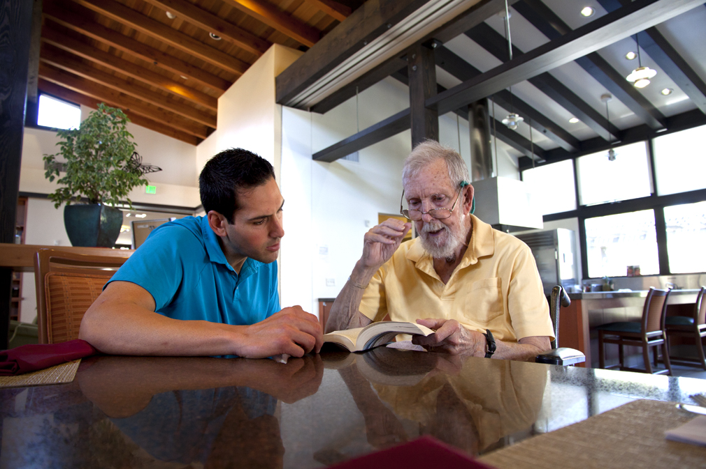
The Green House® Video

Slide 7
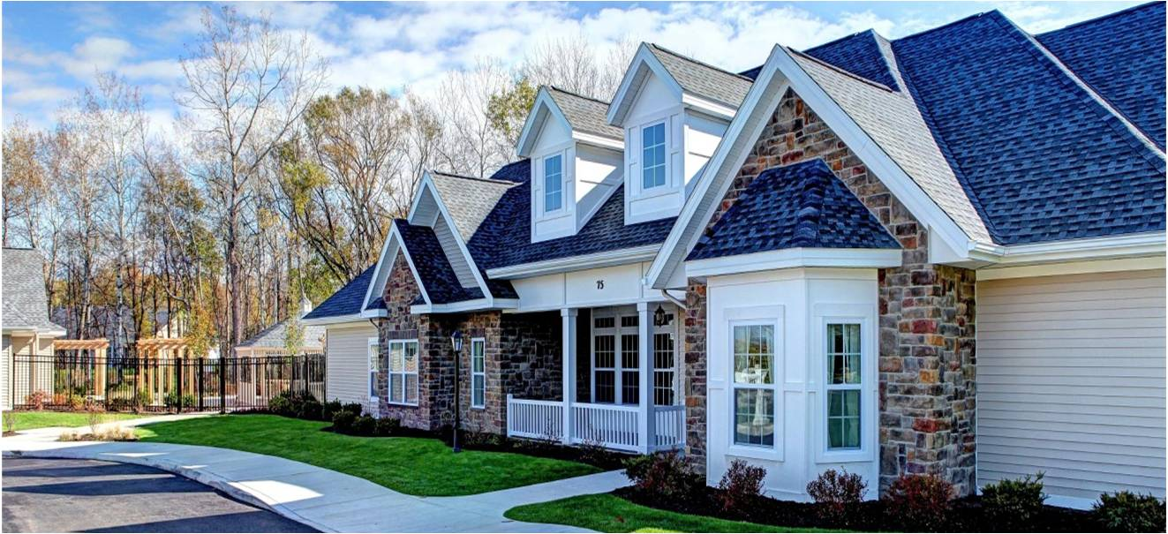
The Green House® Model

Slide 8

The Pinnacle of Culture Change
-- Provider Magazine, 2010

Slide 9
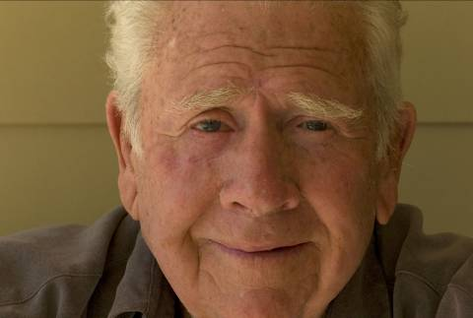
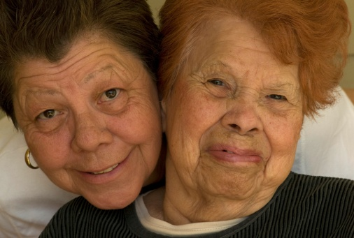
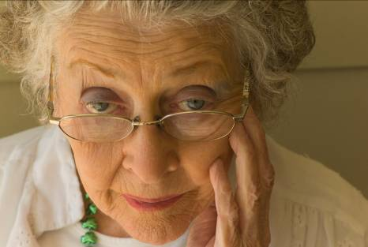
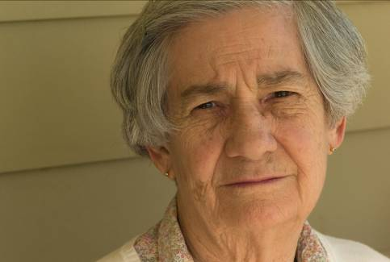
The Green House Project is not a small house movement, but is instead a movement to deinstitutionalize, destigmatize, and humanize care for elders, ensuring ALL elders live LIFE …their Best Life.

Slide 10

The Green House® Model – Core Values
Real Home -PHYSICAL ENVIRONMENT
All areas of the organization are changed to fully embody Meaningful Life, Real Home and Empowered Staff. Each key aspect: physical environment, philosophy of care and organizational practices work in concert with one another to create the maximum benefit for the Elders and staff.
Meaningful Life -PHILOSOPHY OF CARE
Empowered Staff -ORGANIZATIONAL PRACTICES

Slide 11
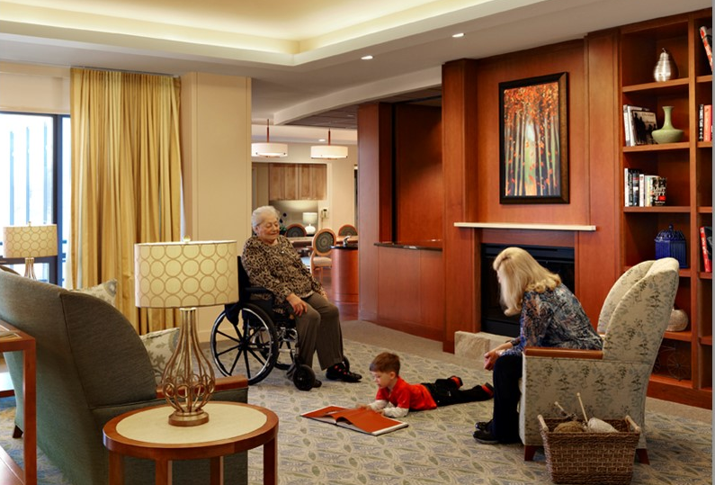
Real Home

Slide 12
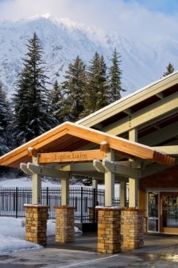
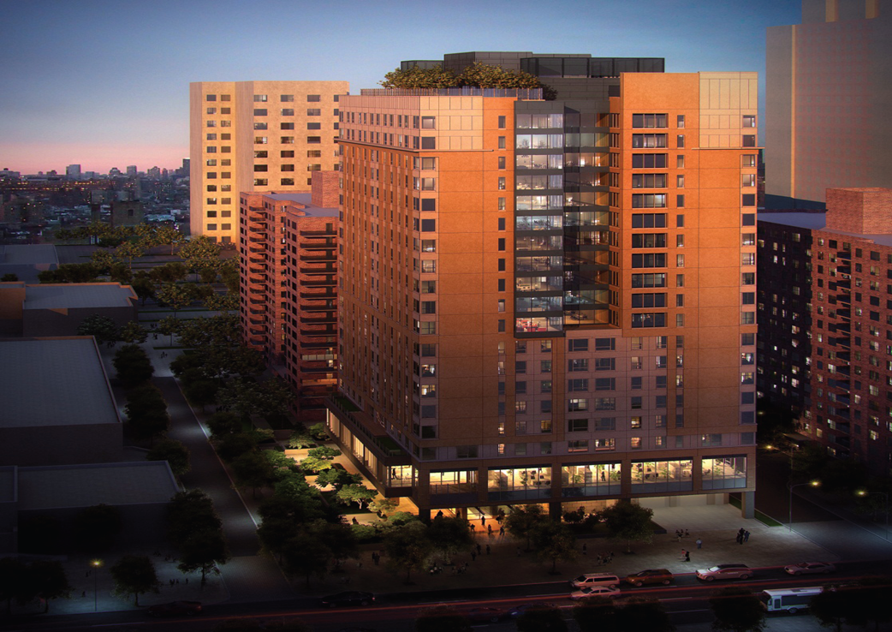
What is “real home?”
Similar to the surrounding community
Notes:
Green House® homes are designed to look like a home in which an elder would have lived in his community.
Therefore, designs vary from place to place.
In rural and suburban communities, there will be single-family homes, in urban areas, high rises.
Warm: welcoming/connection
Smart: High Tech, High Touch
Green: Growth
Intentional Community: really make a choice to have those connections, honoring individual rituals, needs and preferences
Convivium: good food with good people– everyone has a place at the table!

Slide 13
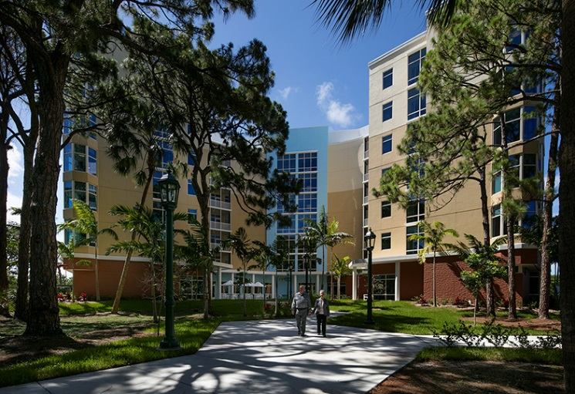
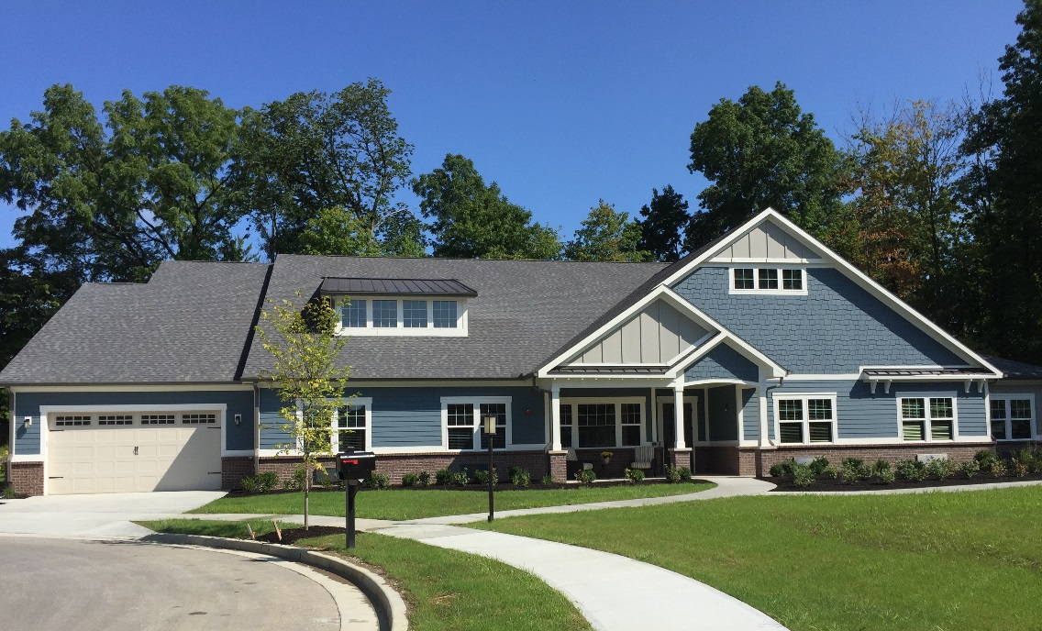
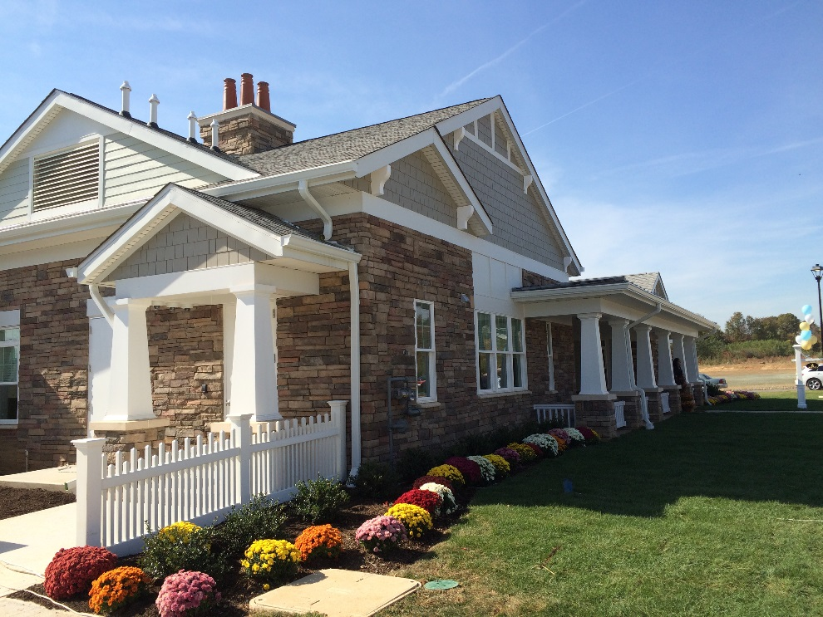

Slide 14
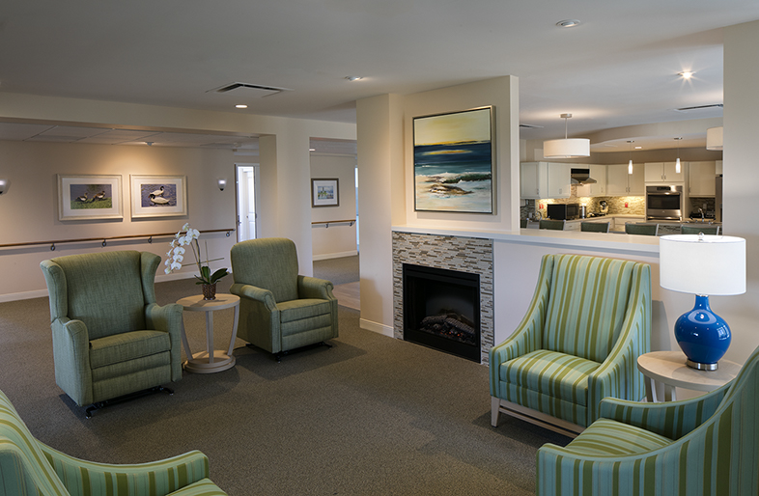
Key Elements: Hearth
Open plan Living, Dining, & Kitchen
Notes:
The open living room/kitchen/dining room design of the green house lends itself to the building of relationships within the house.
"No social group, whether a family, a work group or a school group, can survive without a constant informal contact among its members"
The hearth offers those opportunities and creates a natural focus for talk, dreams and thought. It opens the space in the house and creates a central connection with other spaces and activities.

Slide 15
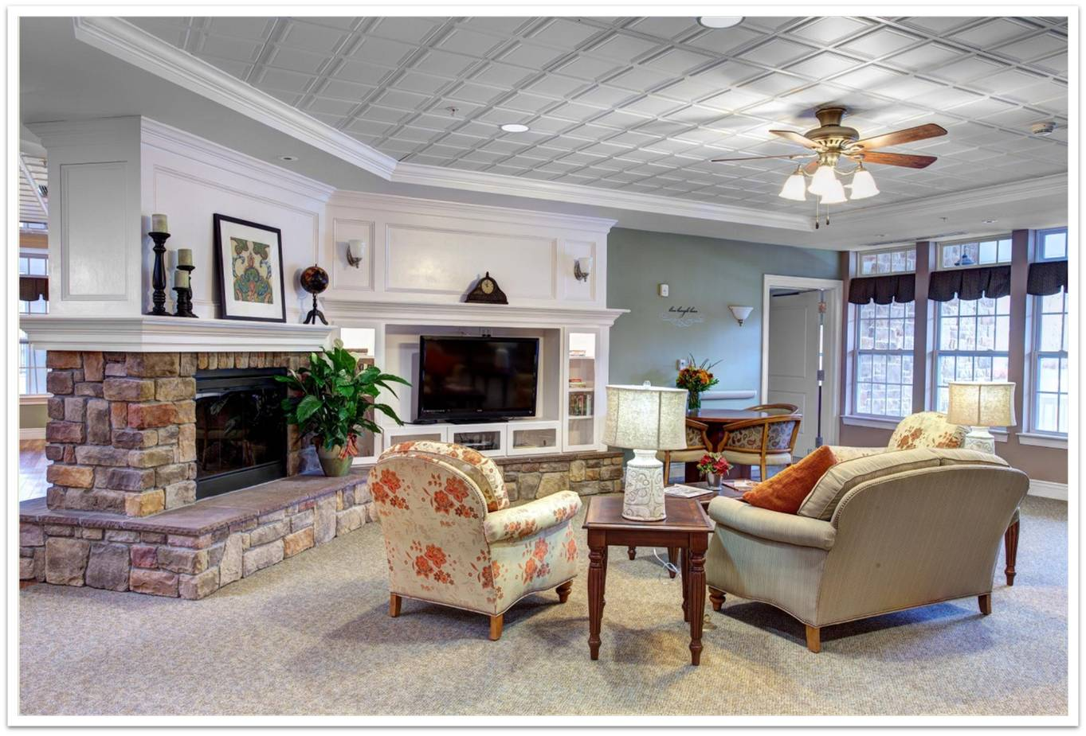
Living Room

Slide 16
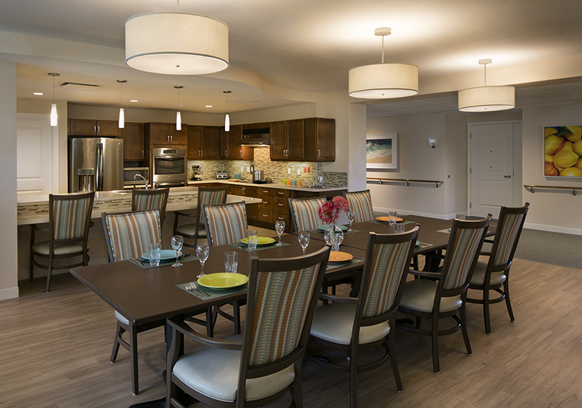
Open Kitchen

Slide 17
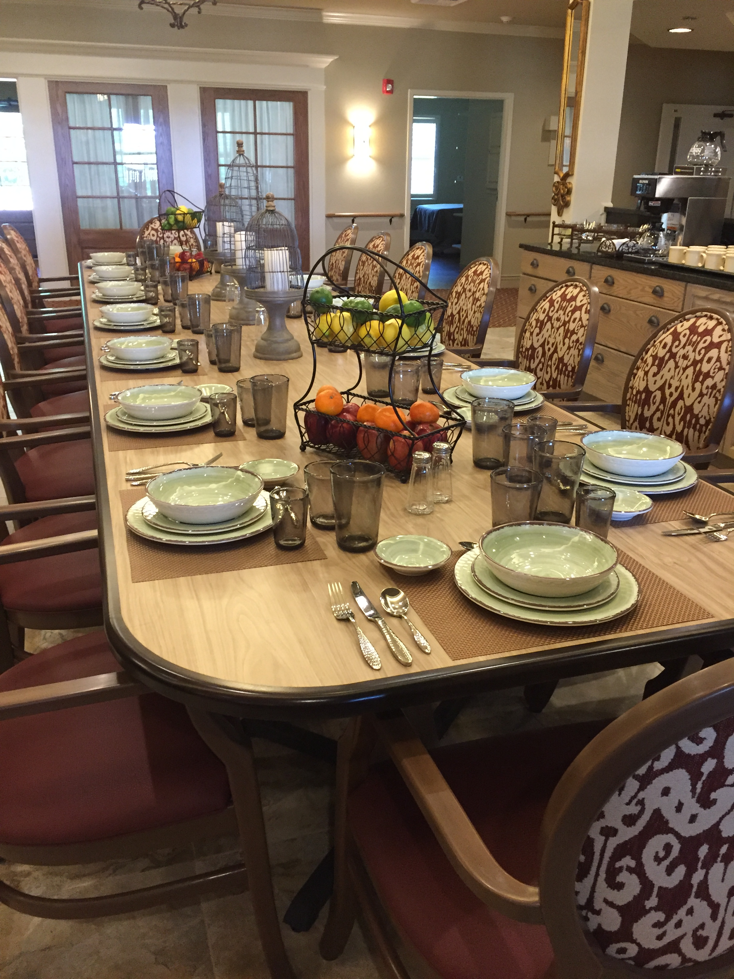
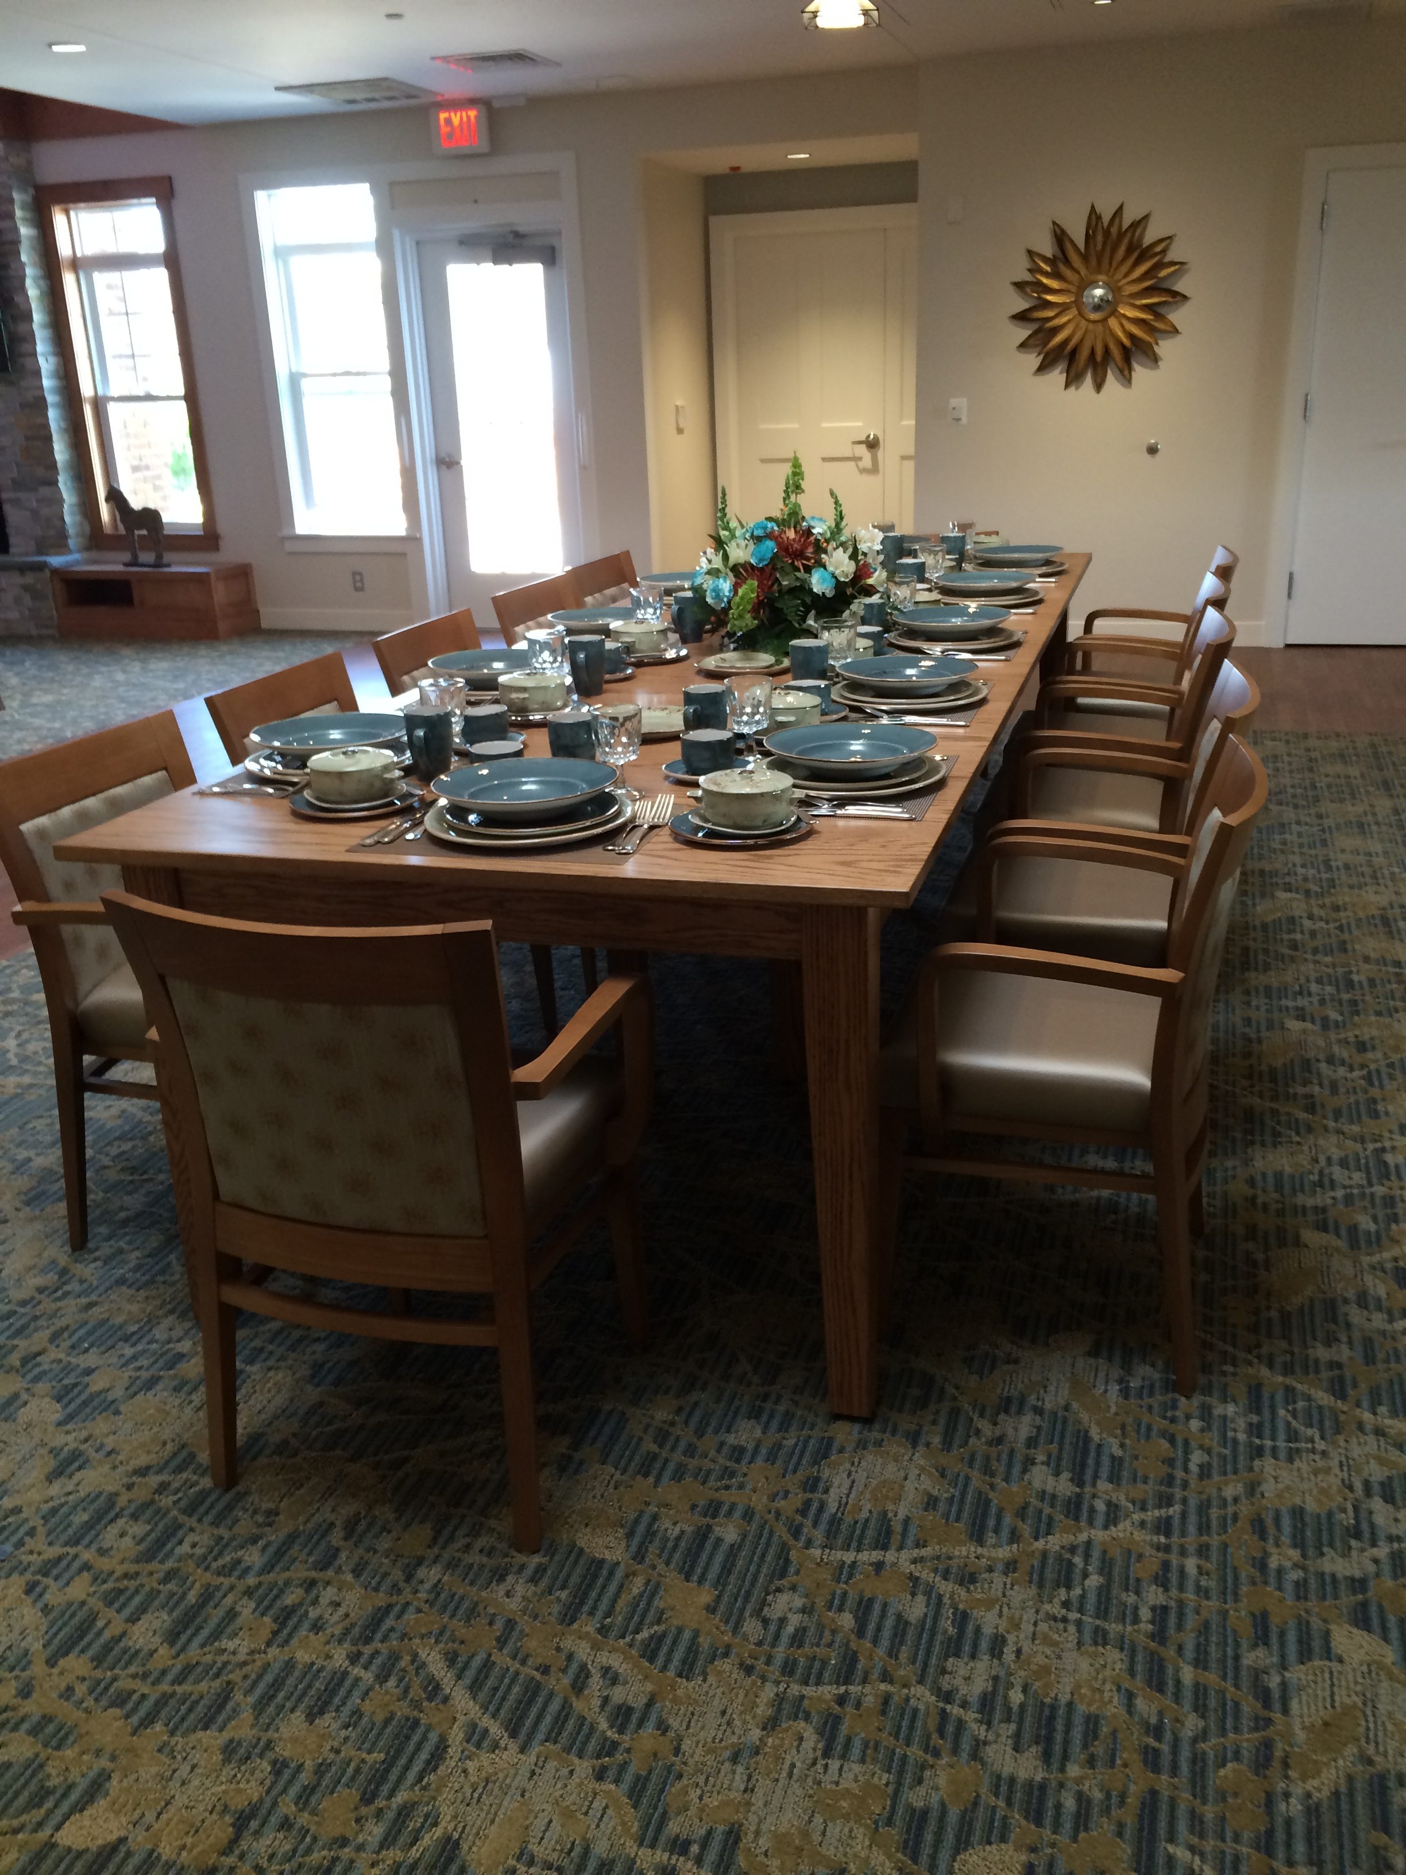
Dining Room

Slide 18
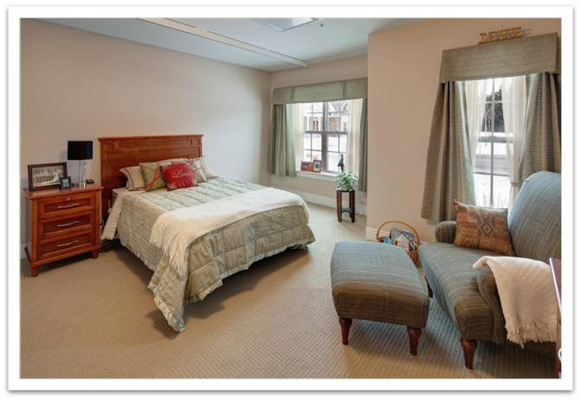
Private Bedrooms
Bedroom: 210 NSF

Slide 19
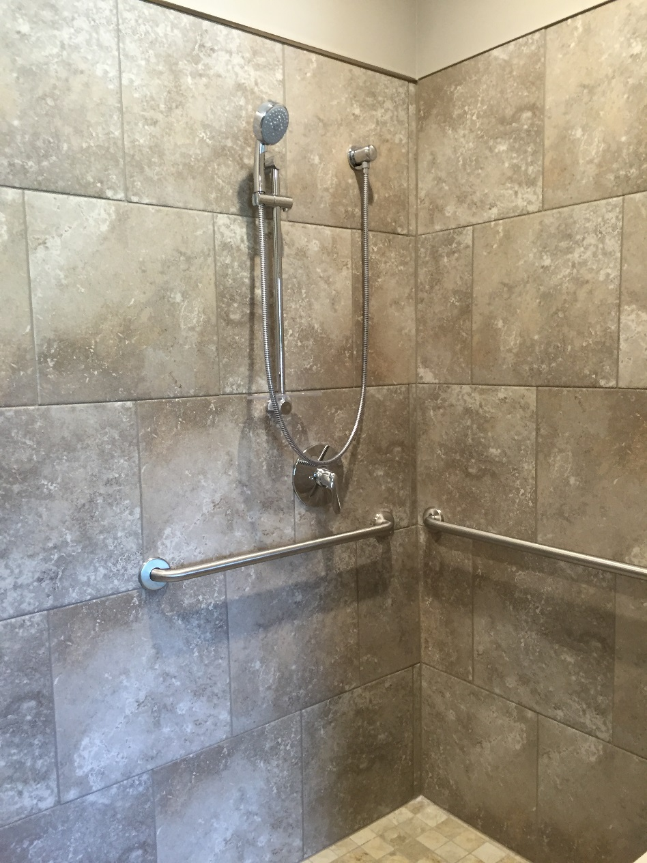
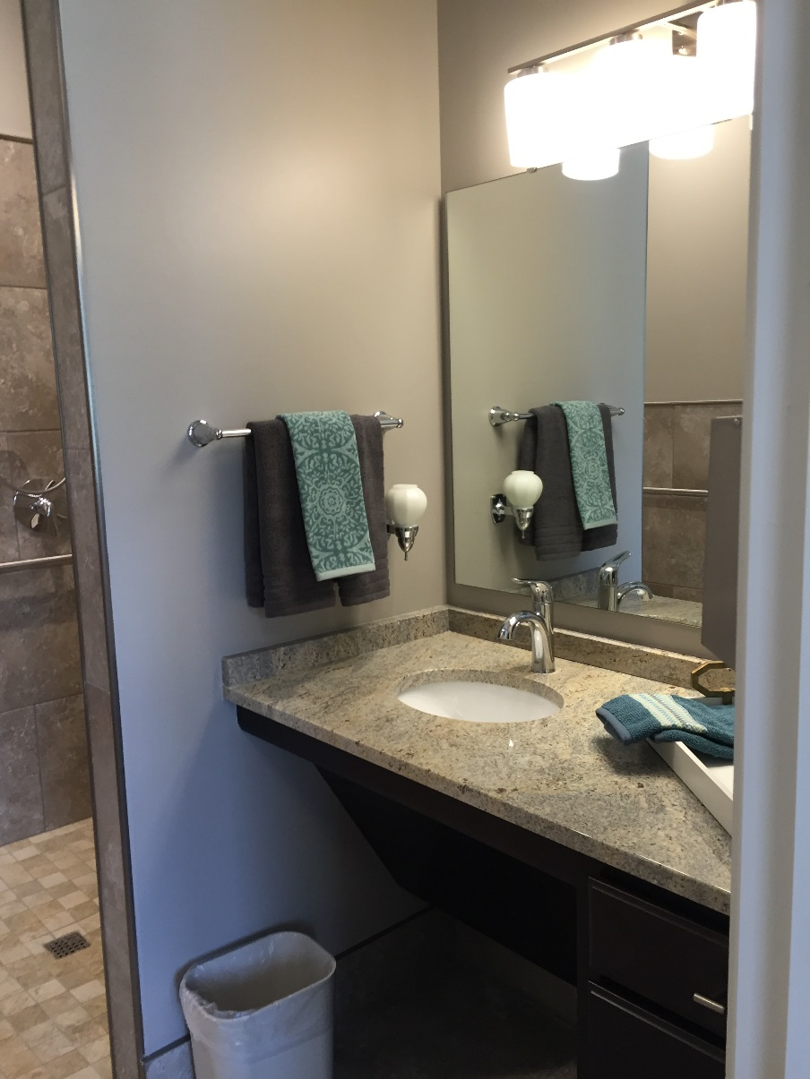
Private Baths
Private Bathrooms

Slide 20
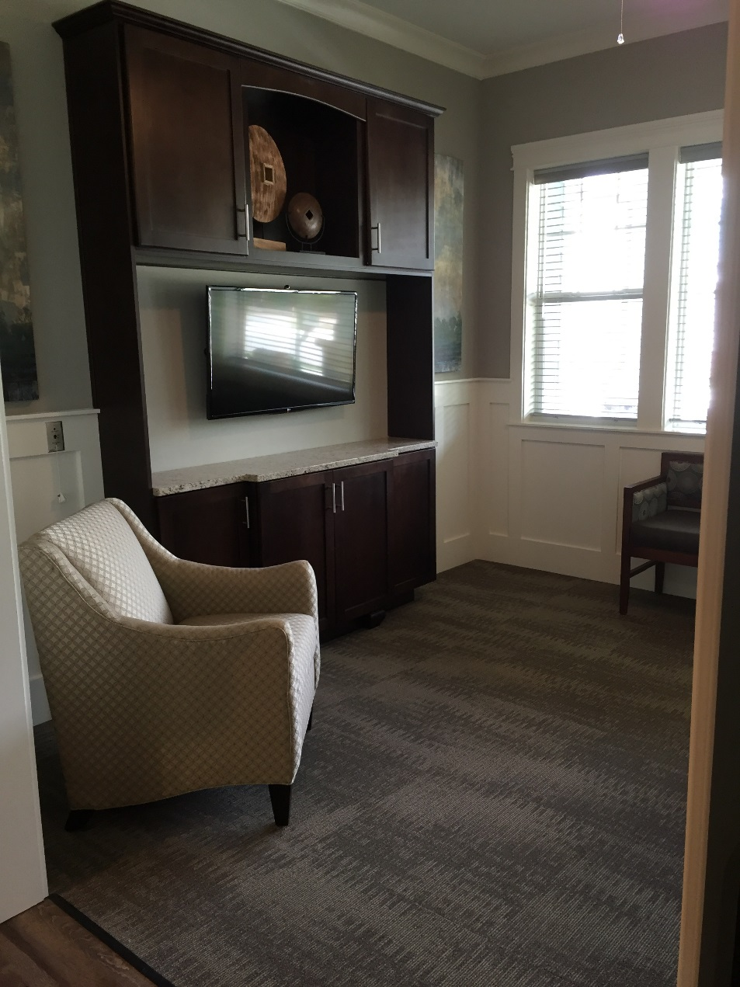
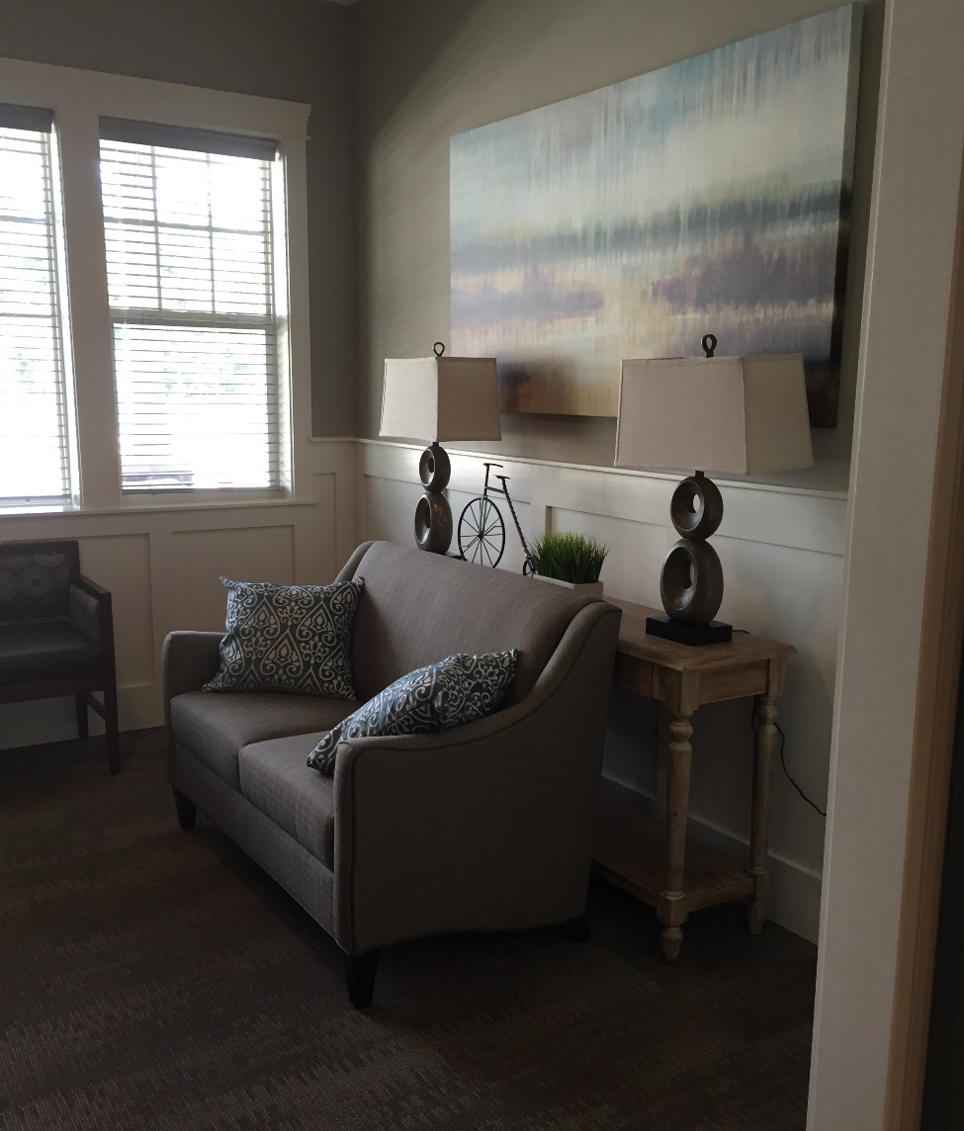
Den

Slide 21
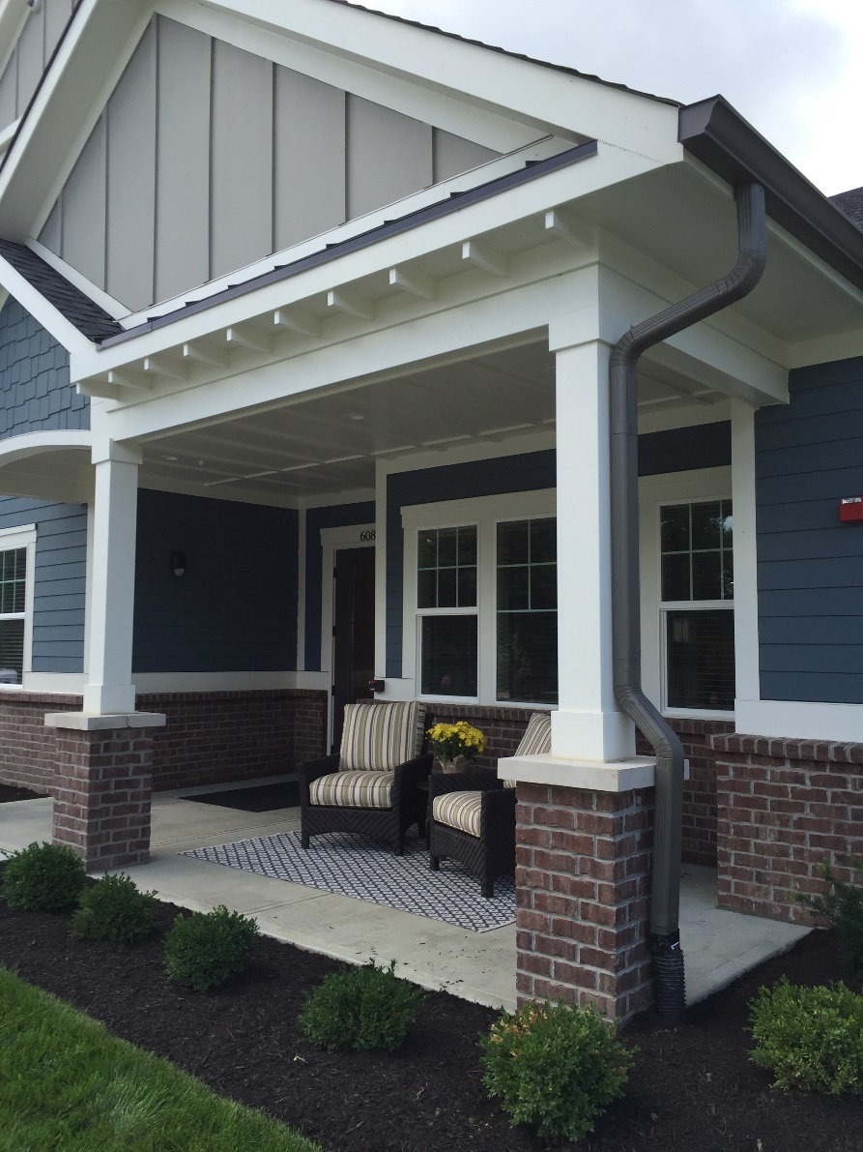
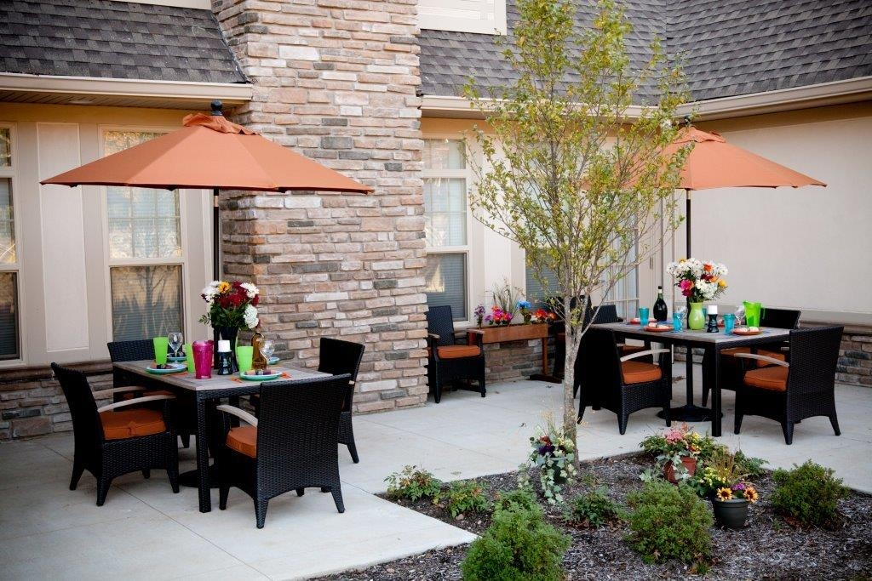
Easy Access to Outdoors

Slide 22
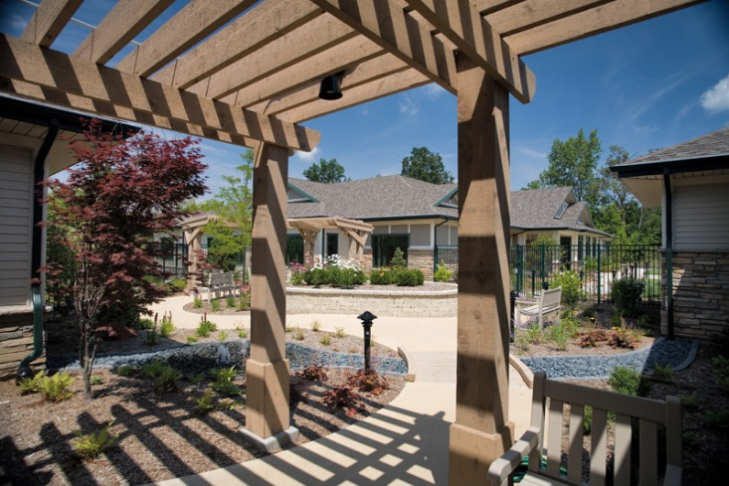

Slide 23
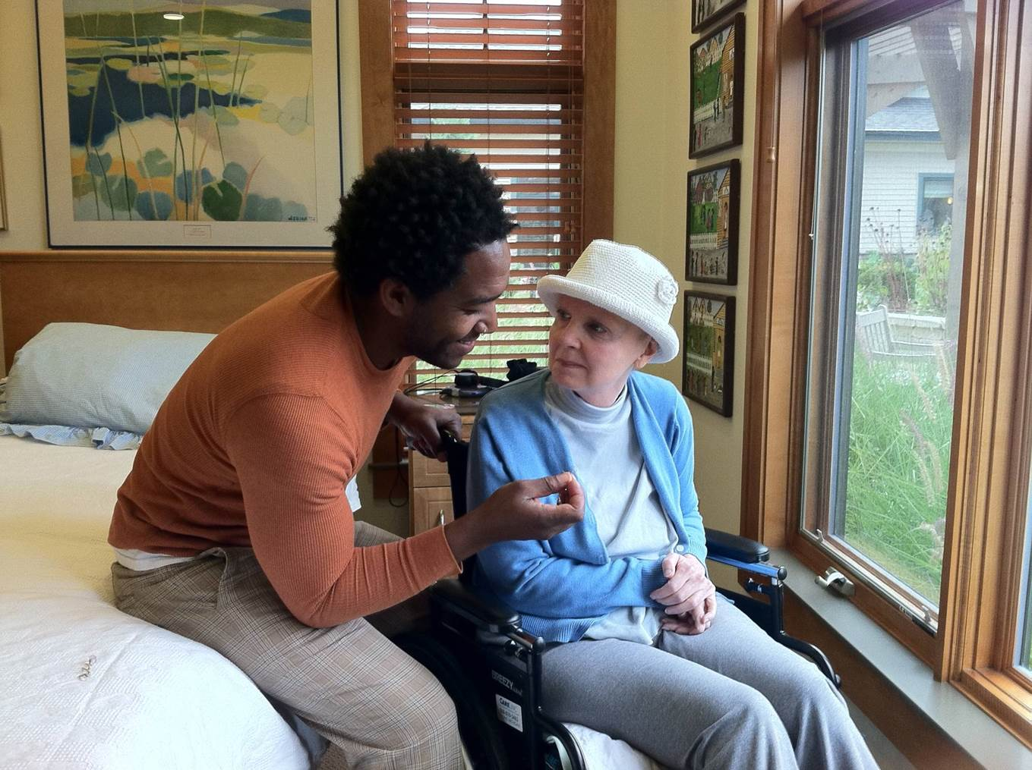
Meaningful Life – It’s All About Relationships

Slide 24
What is Person Directed Care?
Provider Directed
Management makes most of the decisions
Staff Centered
Staff consult residents while making decisions
Person Centered
Resident preferences form the basis of decision making about some routines
Residents accommodate staff preference and expected to follow routines
Residents accommodate staff much of the time, but have some choice within existing routines and options
Staff begin to organize in order to accommodate resident preferences.
Person Directed
Residents make decisions everyday about their individual routines.
Staff organize their hours, patterns, and assignments to meet resident preferences
Continuum of Person Directedness

Slide 25
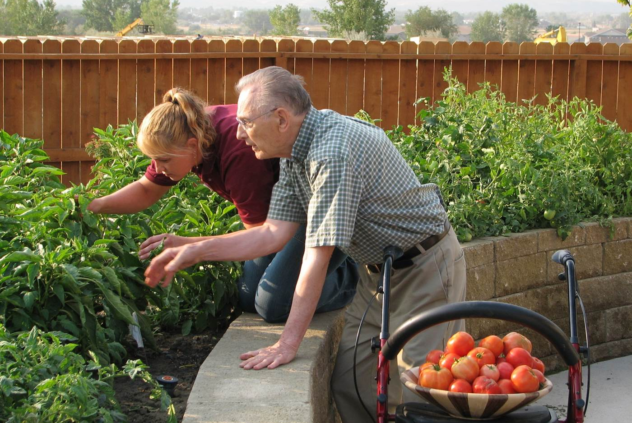
Relationship-rich Elder Directed Living

Slide 26
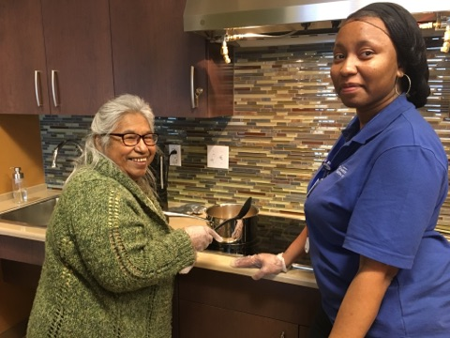
Empowered Staff – It’s All About Leadership
Notes:
Deep Culture Change
Hierarchy Flattened
Elders Rule!!
Creating conditions for empowerment, not simply “empowering” staff.
Over 200 hours of education equip team members with skills to communicate, coach and create sustainable systems for change
Shahbazim work in a Self-Managed Work Team
Group of CNAs who are empowered, responsible and trusted to manage The Green House home
Work collaboratively with leaders and members of the clinical support team

Slide 27
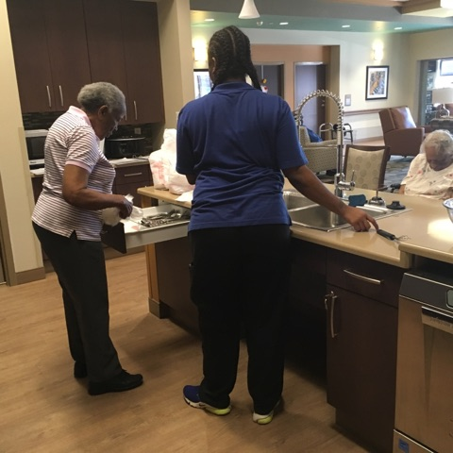
Empowered Staff – The Human Architecture
Places the elder at the
heart of the organizational chart
Redefines roles and responsibilities of all core staff
Radical change in leadership style
Notes:
Elder’s Rule, and are at the center of the organizational chart
Leadership changes from a telling approach to a coaching approach– balance support and accountability
Partnership of clinical professionals with the deep knowing of the versatile worker

Slide 28
The Paradigm of Power
Administrator
Director of Nursing
ADON
RN Supervisors
LPN’s
C.N.A.’s
Dietary Supervisor
Cooks
Diet Techs
Dishwasher
Environmental
Supervisor
Housekeeping
Supervisor
Housekeepers

Slide 29
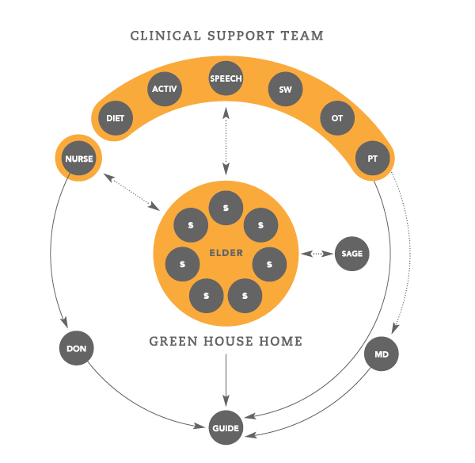
Organizational Redesign

Slide 30
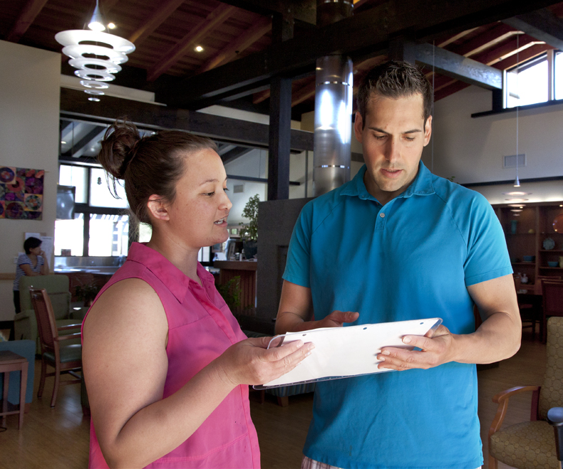

It’s All About Leadership

Slide 31
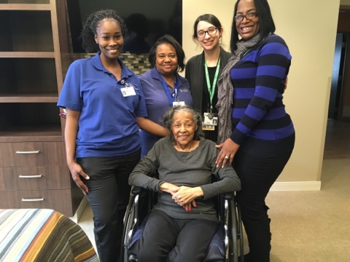
Self-Managed Work Team
Group of Shahbazim who are empowered, responsible and trusted to manage the Green House home
Work collaboratively with leaders and members of the clinical support team

Slide 32
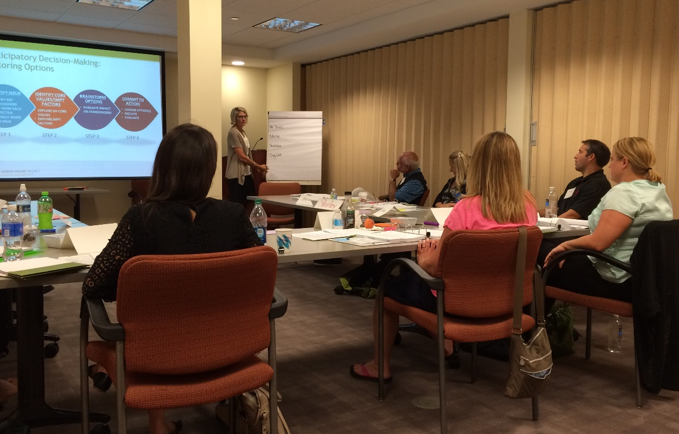
Empowerment through Education
CNA – required as a foundation
128 Hours additional training:
  Safe food handling
  CPR / First Aid
  Culinary skills
  Home maintenance/
  management skills
  48 hours Green House Training:
    Dementia care
    Critical Thinking for Clinical Excellence
    Communication
    Teamwork skills
    Policies & Procedures

Slide 33
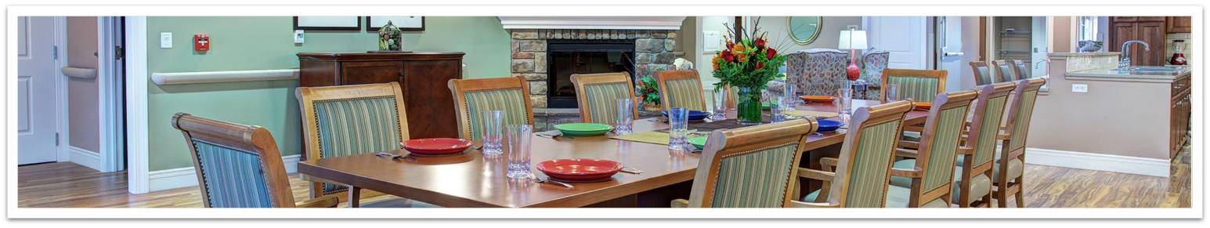
Achieving Success … living the values
Meaningful Life -- It’s all about relationships – Relationship based care that brings life to elders
Empowered Staff -- It’s all about leadership -- Establishing a coaching culture
  Fully empowered SMWT → HIGH PERFORMING TEAMS
    Disseminating information
    Coordinator roles and role ownership
    Balancing support and accountability
Real Home – The power of normal

Slide 34
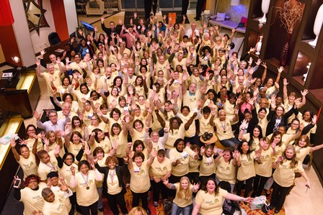
The Green House Peer Network: A Community of Thought Leaders

Slide 35

Adapting the Model
Urban model
Short-term rehab
Homes for ALS, MS
Adaptations of the Model:
Urban style
Short-term rehab
Homes for ALS, MS

Slide 36

GH Model Adaptations:
PACE
Homes for individuals with developmental disabilities

Slide 37
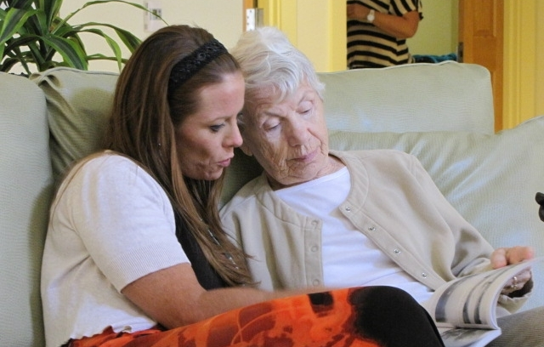
Alzheimer’s and Dementia Care in GH Homes

Slide 38


Best Life Core Principles
Real Home
Empowered Staff
Meaningful Life
Best Life Core Components
Core Values
Culture
Meaningful Engagements
Health & Wellbeing
Power of Normal
Greater Community Integration
Focus on Retained Abilities
Dignity of Risk
Age-appropriate interactions
Elder-directed, relationship-rich living
Advocacy

Slide 39
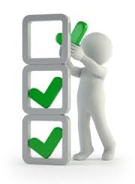
Best Life is NOT …
A specialized program advocating for segregation of elders living with dementia
An education and training program

Slide 40
Best Life is …
A philosophy of comprehensive culture change that embeds new mindsets and beliefs, so that elders are seen
as unique individuals, in the driver’s seat of their lives,
each with a unique history,
preferences and the ability to exercise choice.
In this relationship-rich culture, the
person comes before task, and sets a tone
for how elders will be cared for as well as
how staff will treat one another.

Slide 41

Integration
Occurs first in our MINDS
Sees the person first
Values diversity
Ensures ALL elders are living their best life
  Integrated with life
  Integrated into the greater community

Slide 42
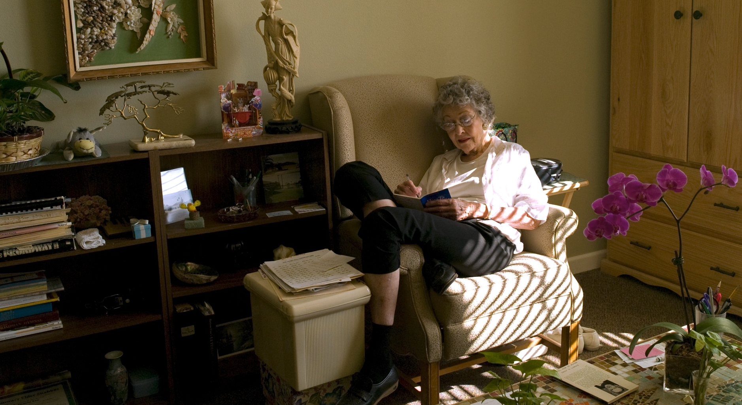
The Power of Normal

Slide 43

Protecting the investment in the brand – MERIT
Our collective voice becomes louder and our impact stronger when we come together to create unified change.

Slide 44
Monitoring and managing towards success –
MERIT
Meaningful Life
- Elder Well-being and Autonomy
- Physical & Organizational Support for Meaningful Life
Real Home
- Residential Life
- Convivial Meals
Empowered Staff
- Organizational Design
- Shahbazim Role
- Collaborative Culture
Model Support
- Leadership Support
- Educational Support

Slide 45
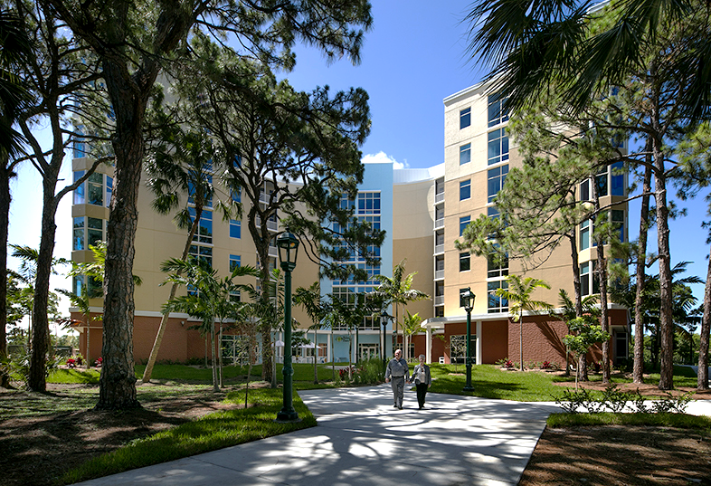
Elder Driven Vision

Slide 46
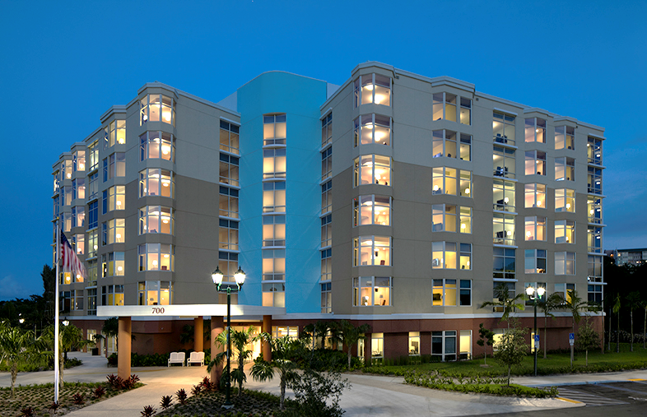
Award Winning Design
Notes:
LEED Gold
EFA Citation of Merit Feb 2017

Slide 47
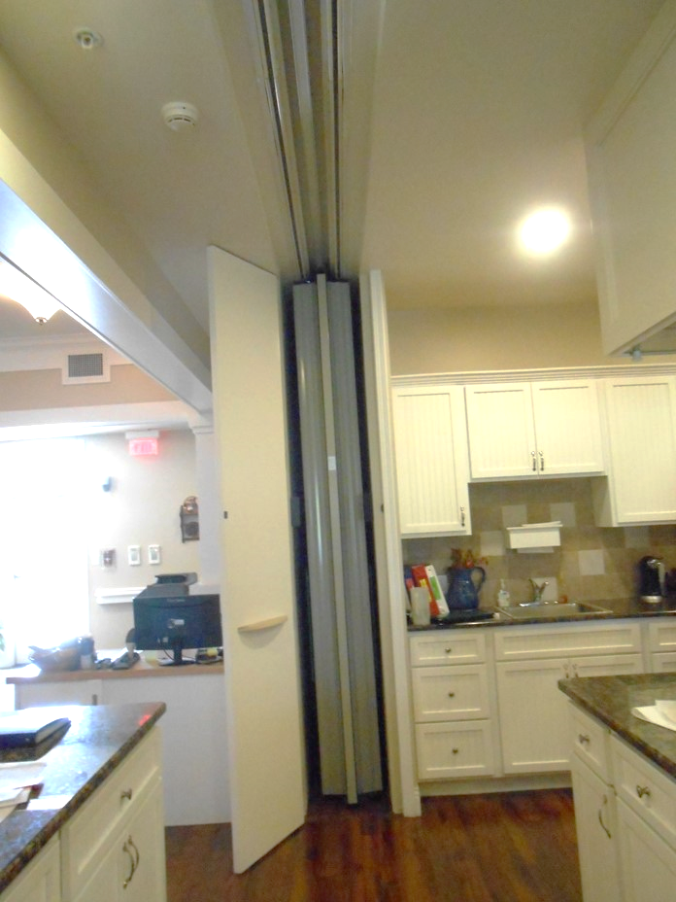
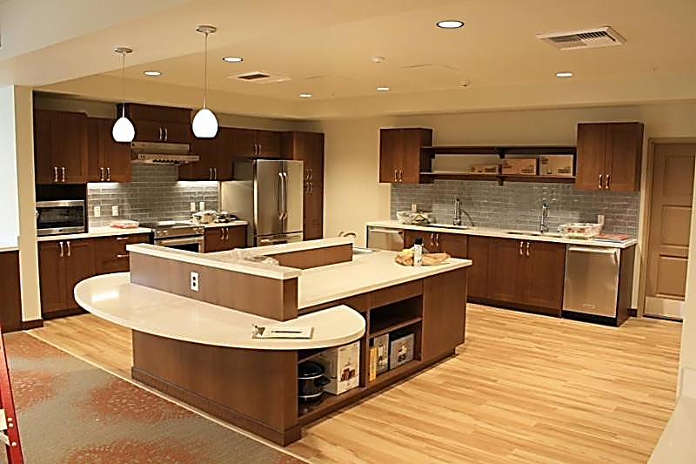
Evolution of Design
Then…
Now
Notes:
Reg Process Description and why: 4 mtgs with Regulators
1) 2012 Tallahasse 2) Miami – Architectural review in 2012 3) AHCA Tallahasse in 2014 4) Regional in Del Ray 2016

Slide 48
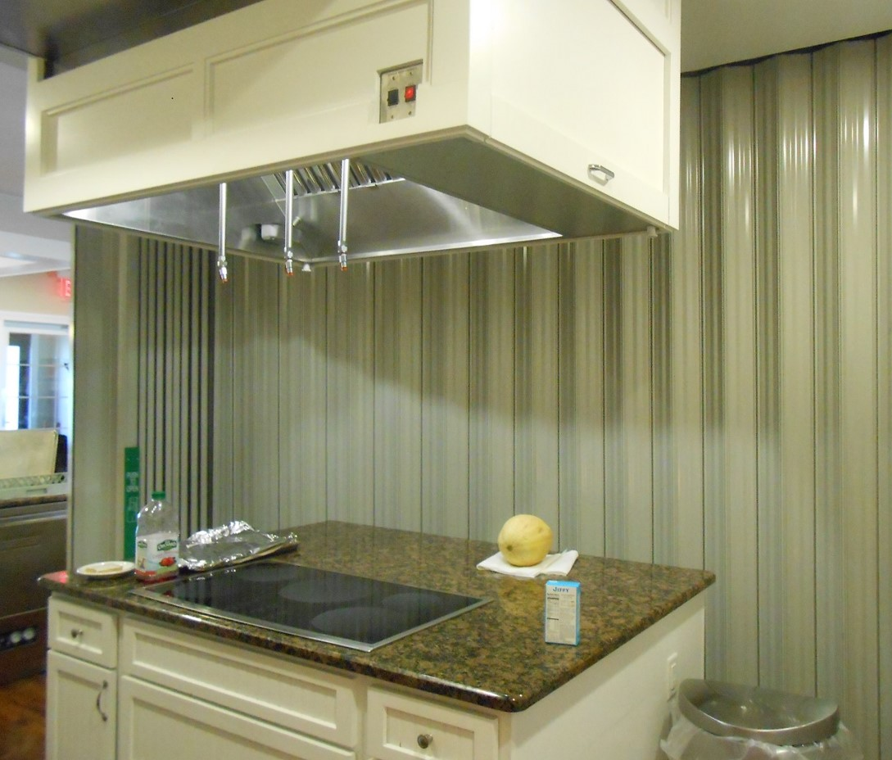
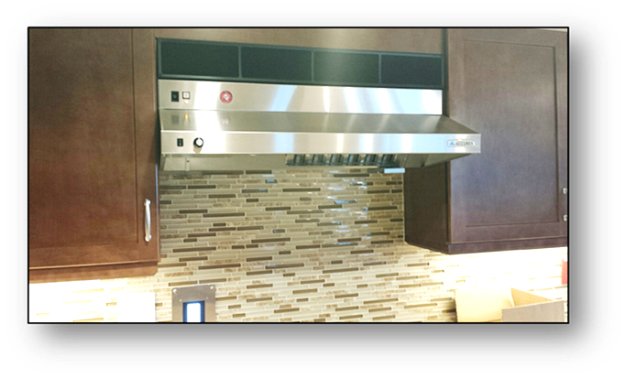
Evolution of Design
Then
Now
Notes:
Key Challenges: Open Kitchen
Resident Doors
Laundry/linen
Call Systems (overall low voltage integration)

Slide 49
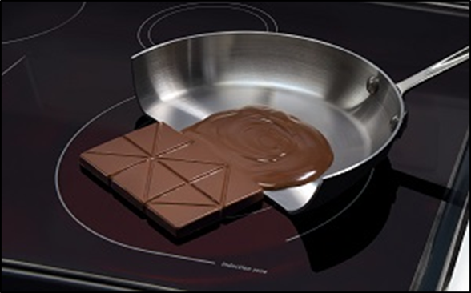
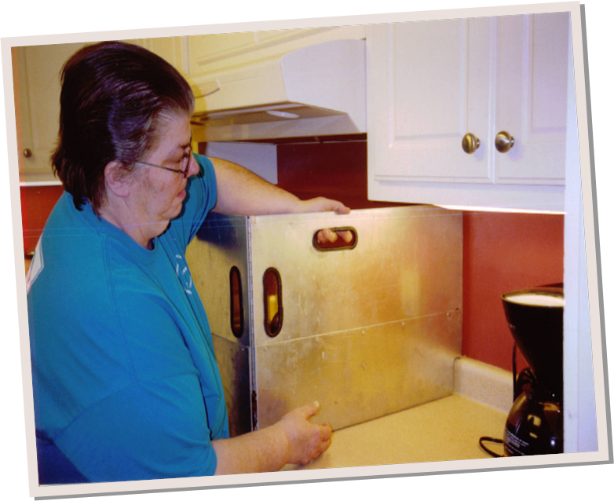
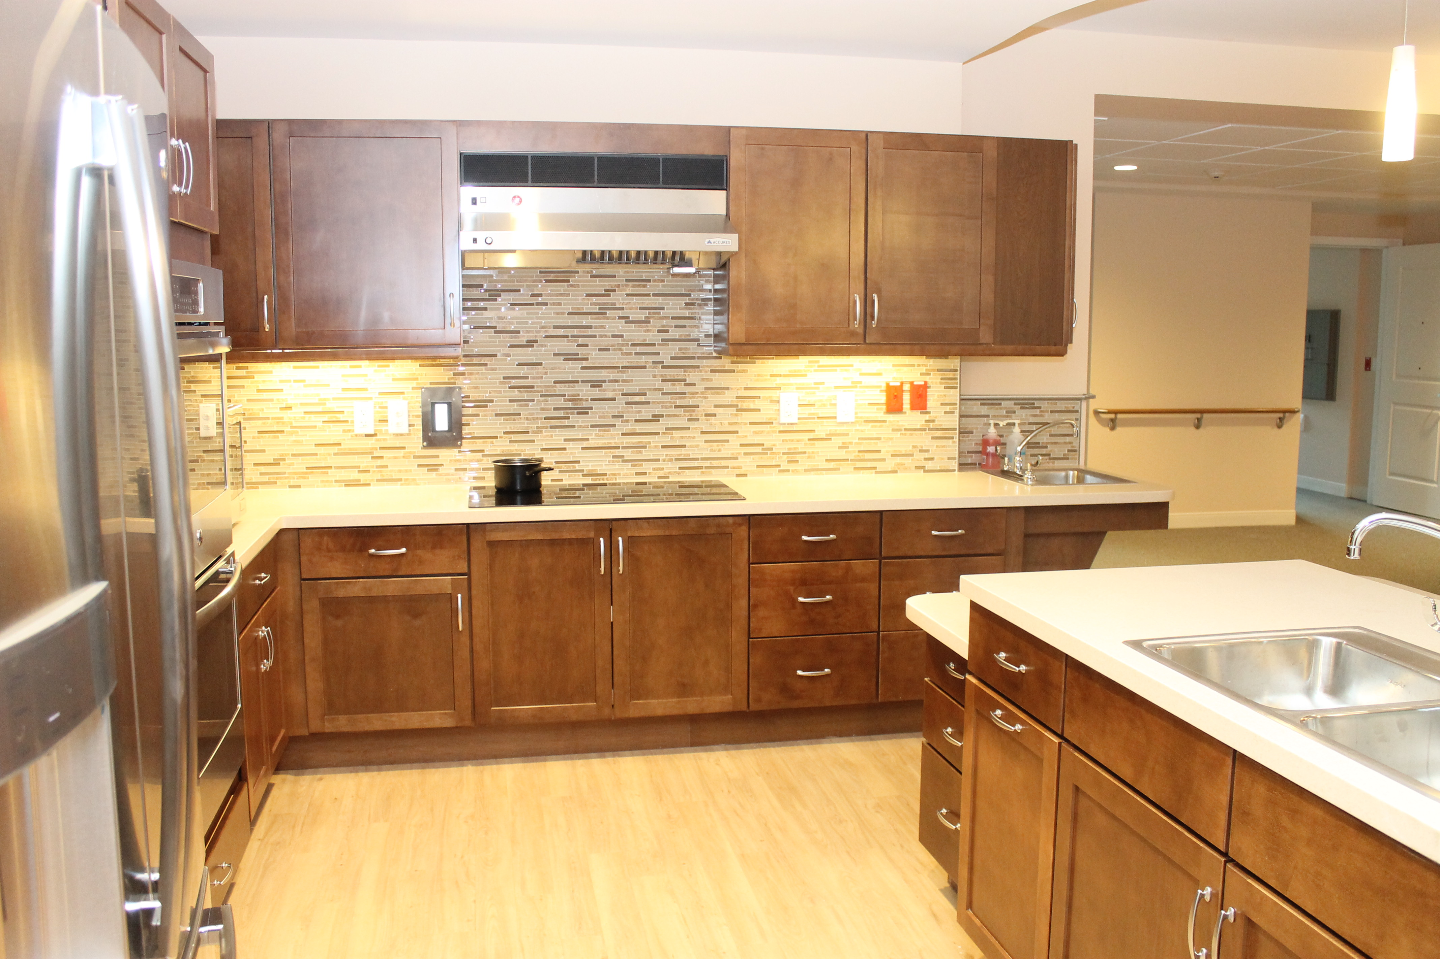
Evolution of Design
Now
Then

Slide 50
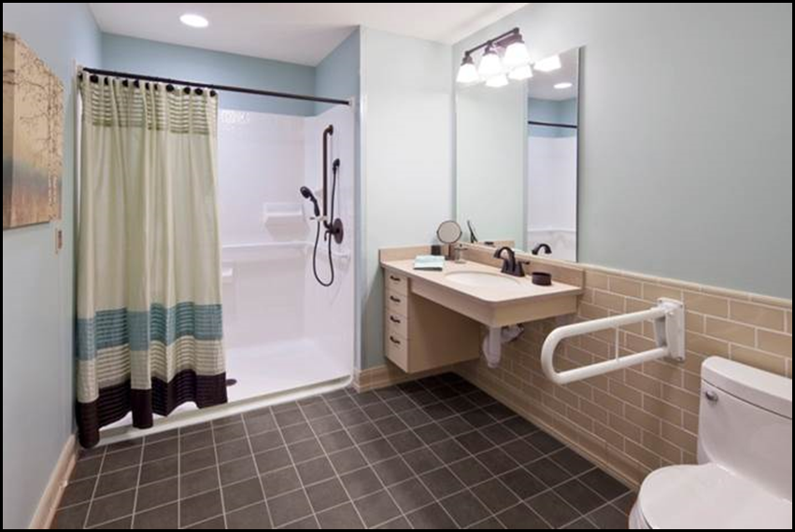
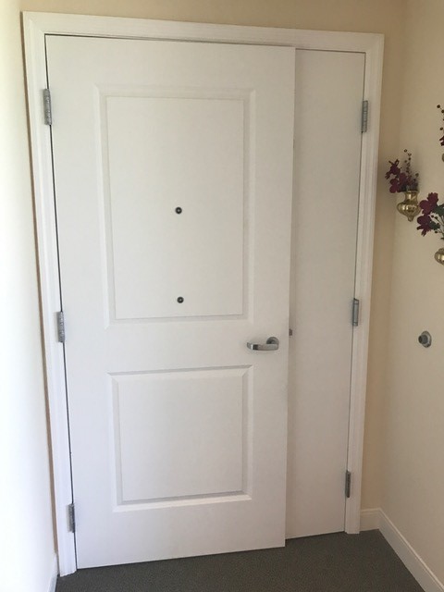
Evolution of Design

Slide 51
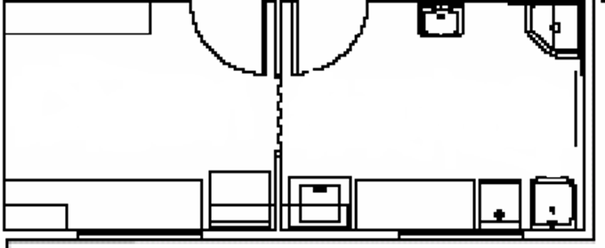
Evolution of Design

Slide 52

Evolution of Design

Slide 53

Functional Rehab in a Home:
Real Home
Highest Functional Outcomes
Lower cost to CMS per episode
  $13,470 vs $12,348
  Saving $1,122 per episode
Average LOS Nationally- 28 days
  20 Days at The Woodlands
Reintegration to community 86% vs. 53% nationally
Highest outcomes, lower costs, lower lengths of stay, lower hospital readmissions, highest reintegration to community
Empowered
Staff
Meaningful
Life
Notes:
PT/ OT/ Speech therapy provided 7 days a week
Specialty homes (Ortho, COPD, ect.)
Decreased Infection
Equipment needs are minimal.
Reinventing the Institutional Model of “Gym Therapy”
Independence to promote dignity is our number one goal!
TMC Rehab- 180 Skilled Nursing Facilities Nationally

Slide 54
Falls 2016
Target <40.2%
EI: Trinity Holy Cross data. Does not include Sound episodes

Slide 55
High Risk Pressure Ulcers 2016
Target <6.5%

Slide 56
SNF Performance Network: BPCI Ortho Performance
Represents all at-risk Holy Cross Orthopedic BPCI episodes discharged to the performance network from Q3 2015 – Q3 2016 based on February 2017 claims files. Figures are not adjusted for case mix. Q3 claims not yet complete. Purple represents adjusted historic values.

Slide 57


Slide 58

Momentum
Operating
233 homes
On 49 campuses
In 32 states (AK, AL,
AR, AZ, CA, CO, FL, GA, IL, IN, KS, KY,
MA, MD, MI, MN, MO, MS, MT,
NE, NJ, NY, OH, OR, PA, RI, TN,
TX, VA, WA, WI, WY)
In Development
150+ homes
On 24 campuses
In 2 additional states
(NV, VT)

Slide 59

300 Green House homes open in 33 states by 2018!
1st 100 GHH:
  2003—2011
2nd 100 GHH:
  2012-2016
3rd 100 GHH:
  2016-18

Slide 60


Slide 61

Questions?

