Slide 1
State and Federal Partnerships to Improve Response to Healthcare Associated Infection (HAI) Risks and Antibiotic Resistance (AR) Threats
Presented at the
AFHSA Annual Conference
August 22, 2017
Joe Perz, DrPH MA
Division of Healthcare Quality Promotion, CDC
Daniel Schwartz, MD MBA
Survey & Certification Group, CMS
The findings and conclusions in this report are those of the authors and do not necessarily represent the official position of the Centers for Disease Control and Prevention.

Slide 2
Presentation Objectives
Identify potential challenges with information sharing and strategies to overcome
Explore opportunities for improved communication and coordination with state survey agencies regarding serious infection control breaches
Describe current public health approaches and new initiatives including CORHA (Council for Outbreak Response: HAI/AR pathogens)

Slide 3
Background: Partners in Prevention
State Survey Agencies play a critical role in the prevention of Healthcare-Associated Infections (HAIs)
  Measuring facility performance against Medicare/Medicaid/CLIA health and safety standards
CMS Survey and Certification Group
  Regional Consortia and Regional Offices
  >200,000 providers/suppliers/labs subject to S&C
Centers for Disease Control and Prevention (CDC)
  Prevention guidelines; HAI surveillance; Outbreak investigation
State Health Departments
  HAI/AR prevention programs
Notes:
A point we’ll be emphasizing repeatedly in this session is that State Survey Agencies play a critical role in the prevention of Healthcare-Associated Infections (HAIs)
As you are aware, this work centers on measuring facility performance against relevant health and safety standards in the context of on-site inspections
Your traditional, close partner in this work is of course CMS’s Survey and Certification Group which operates through the Regional Consortia and Regional Offices. Ultimately, over 200,000 providers/suppliers/labs are subject to S&C and approx 1/3 of these are subject to on site survey
The CDC has long-standing HAI activities specific. These include surveillance activities (many of you are familiar for example with NHSN), outbreak investigation, and the development of prevention strategies and guidelines. As we’ll be discussing this morning, in recent years CDC and CMS have become more active partners in HAI prevention.
This increasing partnership on the federal level is also being reflected on the state level. Traditionally CDC supports state health department activities, for example in the area of communicable disease control. This relationship parallels that of CMS and the SSAs. In the last couple of years we have been fortunate to initiate and grow HAI programs in every state.
As we’ll see, there have been many interesting developments pertaining to HAI prevention that affect State Survey Agencies, as well increasing needs and opportunities for partnership.

Slide 4




Infection prevention needs extend to all areas where healthcare is provided
Acute Care
Facility
Home
Care
Outpatient/
Ambulatory
Facility
Long Term Care
Facility
Notes:
While the initial focus of the HHS Steering Group and Action Plan Activities was on acute care hospitals, there was growing awareness that infection prevention needs extend to all areas where healthcare is provided

Slide 5
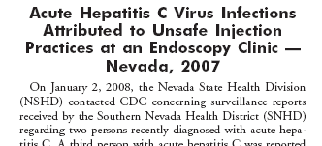
The Las Vegas outbreak
Syringes were reused to withdraw multiple doses for individual patients
Remaining volume in single dose propofol vials was used for subsequent patients
>50,000 patients notified to seek testing
Notes:
The outbreak of hepatitis C virus infections and large-scale patient notification resulting from unsafe injection practices at a licensed ASC in Las Vegas, Nevada, highlight this issue.

Slide 6
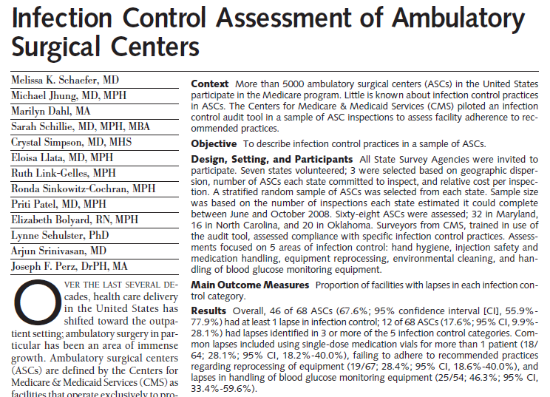

CUSP

Slide 7
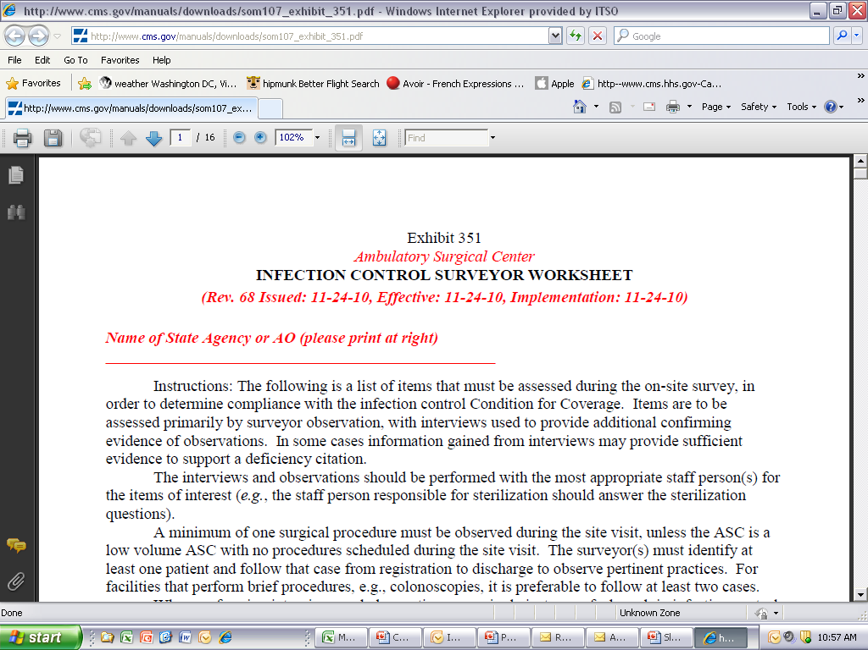
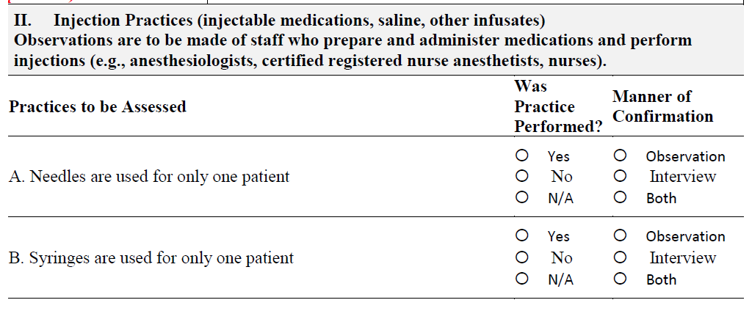
http://www.cms.gov/manuals/downloads/som107_exhibit_351.pdf

Slide 8
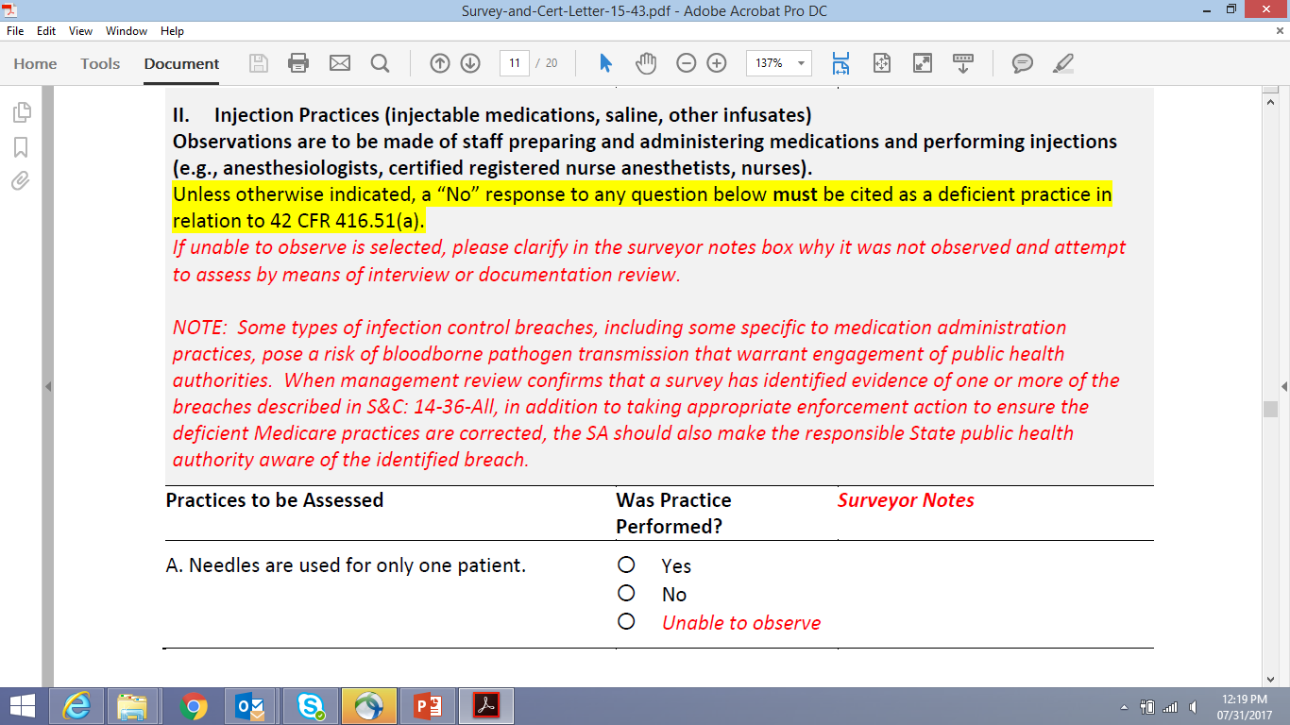

Slide 9
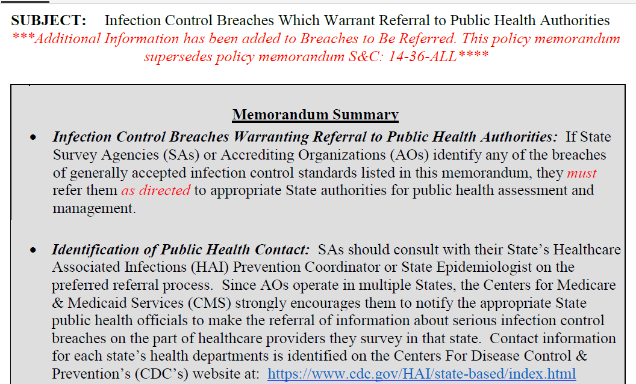

Slide 10
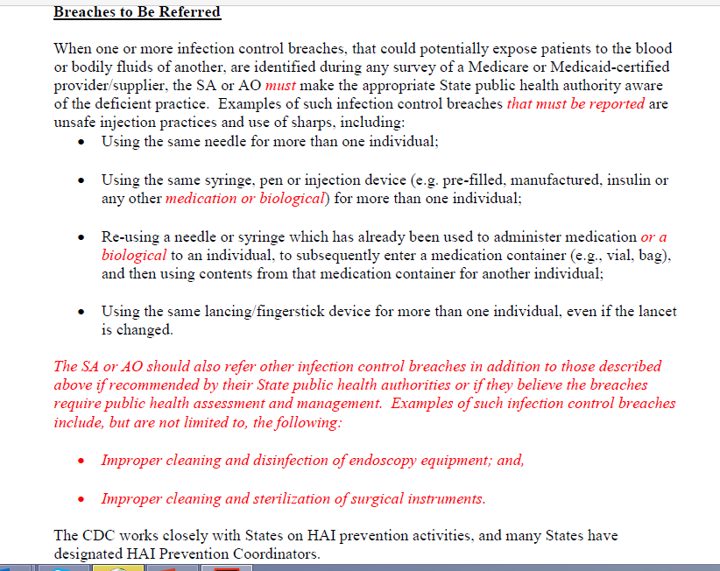

Slide 11
IC Breaches During CMS Surveys
Are you aware of S&C 14-36 Revision?
Are your surveyors reporting breaches to their State HAI Coordinator or SHD?
Are they sharing critical survey findings?
Is there a feedback loop?
Has reporting led to outbreak prevention?

Slide 12
9 cases of HCV transmission over 8 years
  Health department was not notified of seroconversions
  Patients themselves were not informed that they tested positive
SSA found multiple infection control breaches
  Inadequate cleaning and disinfection practice
    Visible blood remained on dialysis chairs, dialysis machine surfaces, and surrounding floor between patient treatments
  Direct care staff failed to wear gloves , change gloves between patients, or perform hand hygiene after contact with patients and soiled surfaces
Facility surrendered its operating certificate and paid $300K civil penalty

Slide 13
Hepatitis B Outbreaks in ALFs
7 HBV infection outbreaks identified 2009-10
  All in residents of Assisted Living Facilities (ALFs) receiving blood glucose monitoring
  62 with new HBV infection
    range 3 – 20/outbreak
North Carolina outbreak¹
  8 acute HBV infections; 6 deaths
2 outbreaks occurred across multiple ALFs
  Single Home Health Agency provided blood glucose monitoring
1: MMWR. 2011 / 60(06);182

Slide 14
Program: Hospital
Date of Survey: June 5 – 9, 2017
Date ITL Declared: June 9, 2017
Reason for ITL:
Infection control breaches identified in the Immediate Use Steam Sterilization (IUSS) process include the following:
  Premature release of implants through IUSS:
One year look-back of records reviewed identified 18 patients who had IUSS of implants.
There were 15 instances of premature release, prior to the biological indicator (BI) being read/finalized.
Nine of 15 premature release occurrences had a documented physician premature release form, leaving 6 without a physician release form. IUSS as indicated for emergent circumstances was not followed per organization policy.
  Lack of adherence to sterilization evidence based guidelines specific to Immediate Use Steam Sterilization (IUSS).
  Lack of adherence to biological indicator (BI) manufacturer instructions for use.
  Lack of leadership oversight and accountability regarding evidenced-based IUSS indications and practices.
Immediately implemented mitigation strategy:
The organization states their intention is-
Memo/letter to the Dept. of Surgery from leadership regarding premature release of implants through IUSS, specifying evidence-based indications for IUSS to include immediate discontinuation of premature release of implants.
Face-to-face meeting with surgeons/medical staff regarding the gravity of the premature release of implants through IUSS.
Revised IUSS policy and procedure.
Departmental huddles to include IUSS discussion.
Focused surveillance of IUSS to include a detailed breakdown of frequency and indications of IUSS.
Central sterile processing has discontinued all IUSS of implants.
Increased instrument levels to minimize necessity of IUSS.

Slide 15
Program: Hospital
Date of Survey: May 2 - 5, 2017
Date ITL Declared: May 5, 2017
High level disinfection of one type of ENT scope was not performed between patient use as required by the manufacturer’s instructions for use (IFU). Second type of ENT scope had unclear cleaning instructions that the organization had not clarified with the manufacturer to determine if the cleaning step was in fact being conducted appropriately.
No evidence of monthly sterilizer maintenance as required by manufacturer’s IFU in the dental clinic.
Lack of daily monitoring of the reverse osmosis system feeding the sterile processing department.
Immediately implemented mitigation strategy: The organization states their intention is to:
Scopes will remain out of use, until staff education is completed
Leadership change will occur immediately – interim leadership to be appointed today (5-5-17)
RCA and risk assessment will drive further mitigation processes
Will speak with Ascension leadership for evidenced based guidelines and guidance
ICP’s to check patients to see what patients were affected
Sterilizer – will have dedicated staff, risk assessment for all clinic sites, and team will ensure that quality checks per manufacturer will be completed – providing standardization for all clinic.
Osmosis system is being cleaned immediately, log sheet to be audited by leadership.

Slide 16
Program: Hospital
Survey dates: June 2-3, 2017
Identified breaches in Sterilization processes
2 sterile supply rooms and 1 sterile processing space did not have the proper positive air pressure relationship to adjacent spaces
Sterile Processing staff approximating cleaning products in 3 of 4 sink basins used for cleaning instruments

Slide 17
Program: Home Health Agency
Date of Survey: May 17 - 19, 2017
Date ITL Declared: May 19, 2017
Reason for ITL:
Using the same glucometer/lancet/fingerstick device for more than one individual/patient. Failure to follow manufacturer instructions for use.
  Two frontline nursing staff independently purchased their own glucometer/glucometer kits. One LPN was observed re-using the device on a second patient. Second LPN used the device on a patient and immediately placed the device in his bag with no device cleaning/disinfection observed.
  Lack of documented education, competency, training of staff that perform glucometer/lancing/fingerstick device testing.
  Lack of knowledgeable accountable supervisory oversight regarding the re-use of a glucometer/lancing/fingerstick device intended for single use that poses a risk of transmission of multiple infectious agents to patients.
  Leadership was unaware that the two frontline staff had purchased and were using their own glucometer/lancet/fingerstick devices.
Mitigation Strategies:
Education of staff regarding use of patients glucometers & single use devices
Revise policy to include cleaning of glucometers
Increase Supervisory visits starting next week

Slide 18
Program: Ambulatory Surgery Center
Date of Survey: May 8 - 10, 2017
Date ITL Declared: May 10, 2017
Reason for ITL:
Infection Control breaches identified in the high-level disinfection(HLD) process
  Sterilization of instruments
    Improper packaging of instruments for steam sterilization
    No following adopted guidelines AAMI st79
    Not following TASS guidelines for cleaning of eye
    Not following guidelines for disposing of sponges and syringes after each use
    LMA’s are reprocessed without specified manufacturer’s instructions
Breaches in Endoscopy
  Endoscopes not wiped down at the Point of use
  Flushing scopes with effluent into solution used for pre-cleaning
  Not following instructions for use when performing leak testing
  Single use brushes reused
  No process for hang time of Endoscopes for reprocessing
  Enzymatic cleaner amount is estimated not measured
  Not following Instructions for Use when flushing endoscopes. Scopes not dried or stored properly
  Rapicide stored in the bottom of Scope cabinets
  Cabinets not vented per Instructions For Use
Competency and training
  Lack of ongoing training for the Lead Endoscopy techs
  Competency for endoscopy was not comprehensive or validated
  Individual signing off on competencies had no training
  Current Evidenced based guidelines are not incorporated into competency and training
  No documentation of ongoing education and training related to IC, sterilization, HLD, TASS guidelines, & SSI
The IC risk assessment does not include risks related to the services provided such as TASS for eyes and c-diff for endoscopy
Improper air pressure in the decontamination room
Several multi-dose medication vials stored in patient care environments specifically in operation room and anesthesia carts.

Slide 19
Program: Ambulatory Health Care
Date of Survey: July 21, 2017
Reason for ITL related to Infection Control:
Infection control breaches identified in the sterilization process include the following:
No documentation of the physical monitoring of sterilization cycles (temperature, time, pressure, reviewer initials) for sterilizers (noted at 2 sites).
Approximating enzymatic product. No accurate means of measurement. Not following manufacturer’s instructions for use (2nd site).
Instrument brushes re-used while visible worn, curled, and in disrepair – not following manufacturer instructions for use or evidence-based guidelines (2nd site).
Sterilization cycle parameters documented as 270 degrees with a 30 minute dry time for all loads for all sterilizers with no evidence of any instrument manufacturer instructions for use to determine specific cycle recommendations. (Site 1)
One of the sterilizer’s instructions (Peyton and Crane manual) states to refer to instrument manufacturer for sterilization cycle parameters.
The Peyton and Crane sterilizer has a dial to set the time parameter. The tech states she sets the time for about 7 minutes for sterilization and 10 minutes to dry, though she says they usually stay in longer. Not following manufacturer instructions for use.
Peyton and Crane sterilizer was noted that when the sterilizer was opened, that a towel was placed on the floor to catch the water pouring out of the sterilizer. After 2 hours of drying in the sterilizer, the packs on the bottom rack remained with visible condensation inside. The response was that the contents would remain inside until dry. Not following evidence-based guidelines regarding appropriate unloading and drying of the sterilizer contents nor questioning whether the sterilizer was working correctly for current, safe and effective use.
Lack of adherence or use of sterilization evidence based guidelines.
Lack of documented initial and on-going competency and training for frontline staff performing sterilization processes.
Lack of leadership oversight and accountability regarding evidence-based manufacturer supported sterilization reprocessing.
Stored paper-plastic peel pouches noted in the following state(s):
4 pouches compromised – 1 with rust/water stained packing; 3 with scissor tips punctured through peel-pouch paper. (1st site)
b. 1pouch with evidence of scissors sterilized in the closed position. (1st site)
c. 8 pouches with no documentation to include date, load contents, or sterilizer used. (1st site)
d. Multiple instruments noted to be sterilized in the closed position. (2nd site)
9. Sterilization reprocessing environment was not traffic controlled or
monitored as patients were permitted to walk through the reprocessing room to access the restroom.

Slide 20
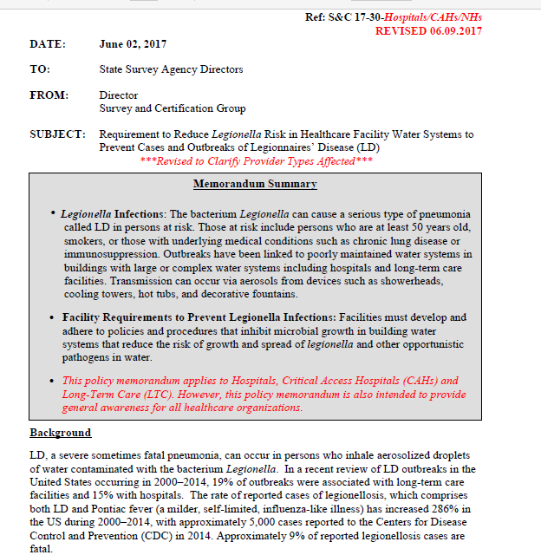

Slide 21
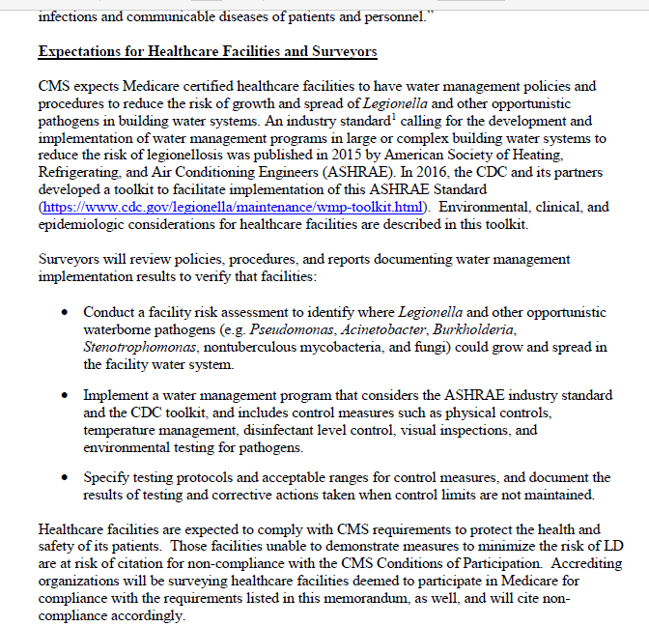

Slide 22
CMS
CDC
State Survey Agencies
State HAI/AR Programs
HAI Risks
AR Threats
QI & Healthcare
Partners

Slide 23
I. Preventing and Monitoring
Promoting Prevention:
Infection Control Guidelines
Prevention Strategies
Health and Safety Standards / Certification
Monitoring:
Surveying
  SSA and Accreditation Surveys
  QI Activities
Surveillance
  NHSN and State Communicable Disease Reporting
CDC
CDC
CMS
State
Partners

Slide 24


Slide 25
II. Responding to Acute HAI/AR Threats
Certain findings or “signals” from our monitoring activities require a heightened response
  “Immediate Jeopardy” concept
  When applied to HAI/AR risks, can take form of
    Recognized outbreak
    Cluster or other potential outbreak
    Hazardous condition (e.g., IC breach such as reuse of syringes)
    Novel pathogens or resistance mechanism
  Investigation components
    Perform risk assessment
    Evaluate transmission mechanisms
    Assess care delivery practices
    Perform case finding / patient notification
    Implement control measures

Slide 26
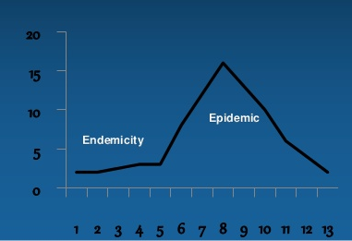
Areas for Improvement as Identified in
State HAI Plans
  Improve detection and reporting of outbreaks, clusters or unusual cases
  →SIGNALS

Slide 27
Areas for Improvement as Identified in
State HAI Plans
  Improve detection and reporting of outbreaks, clusters or unusual cases →SIGNALS
  Establish investigation protocols and train HD staff
  Improve communication about outbreaks or breaches among state and local partners
  (e.g., State Survey Agency, licensing boards)

Slide 28
Example: HAI/AR Program performs an “ICAR” Assessment and identifies reuse of syringes to access a shared saline bag
?
State Survey Agencies
State HAI/AR Programs
IC Breach
Would you expect the Program to contact you?
Under what conditions?

Slide 29
Example: State medical board is notified of a complaint involving a patient death related to an infection following a knee injection
?
State Survey Agencies
State HAI/AR Programs
HAI Risks
AR Threats
?
Should the board notify the state survey agency?
Should they notify the health department?
QI & Healthcare
Partners
If the HAI Program is notified, should they loop you in too?

Slide 30
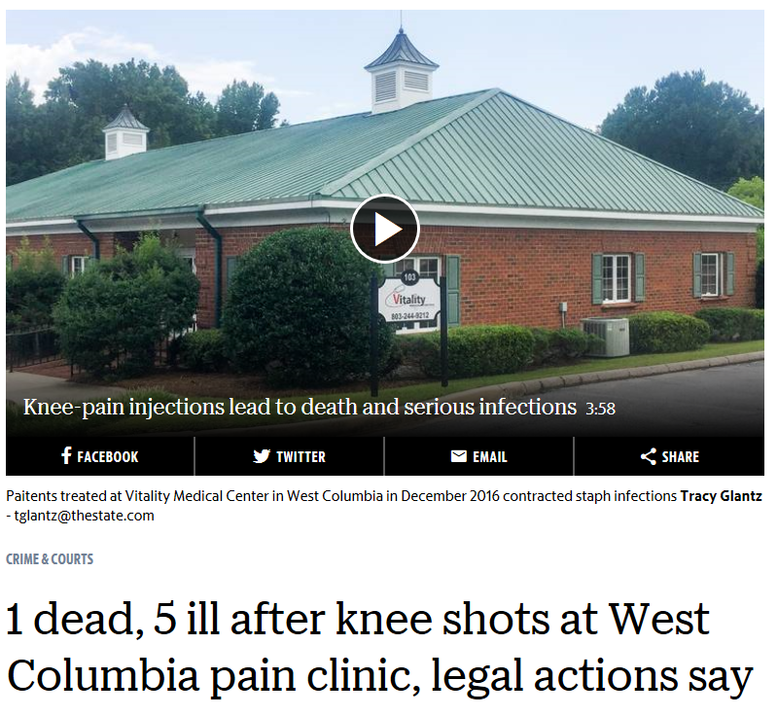

Slide 31
Overview of some CDC-LED activities aimed at strengthening HAI-AR Response

Slide 32
Council for Outbreak Response:
Healthcare-Associated Infections &
Antibiotic-Resistant Pathogens (CORHA)

Slide 33
CORHA Organizational Structure
ASTHO
CSTE
Co-chairs
Governance Committee
CDC
NACCHO
CMS
FDA
SHEA
APIC
WORKGROUPS
Detection and Reporting Investigation & Control

Slide 34
Council for Outbreak Response:
Healthcare-Associated Infections &
Antibiotic-Resistant Pathogens (CORHA)
Next Steps
Workgroup activities – CORHA will manage, support and grow workgroup activities
  Detailed work plans and timelines for product development
Partner Engagement – CORHA will engage additional partners and evolve into a multidisciplinary collective
  Healthcare consumers; medical community; health departments; professional associations; federal agencies
Leverage and complement related activities and investments – CORHA will help collective efforts to improve HAI/AR Response activities nationally, making them more consistent and effective

Slide 35
CORHA Product Offerings
  High-level outputs related to strategic objectives
  e.g., Best practices for improve detection of potential outbreaks using existing data sources
  e.g., Laboratory best practices to support outbreak detection and investigations
  e.g., Suggestions for improving data management for outbreak investigation and response activity tracking
  Suite of event-specific reference tools
  Threshold for reporting and investigation
  Suggestions on how to improve reporting
  Suggestions on how to improve the use of existing surveillance data for detection
  Tools for investigation
  Suggestions for standardized control measures

Slide 36
Some Suggestions for how you can strengthen relations with your HAI-AR program

Slide 37
State HAI/AR Programs: History
2009 ARRA funding established HAI programs nationally and required state HAI advisory groups and state plans
2011 ACA funding continued level support
2015 Ebola supplement (3 year funding) provided first significant increase in support to state programs
2016 AR funding
  Part of CDC core funding
  Sustained HAI Program support

Slide 38
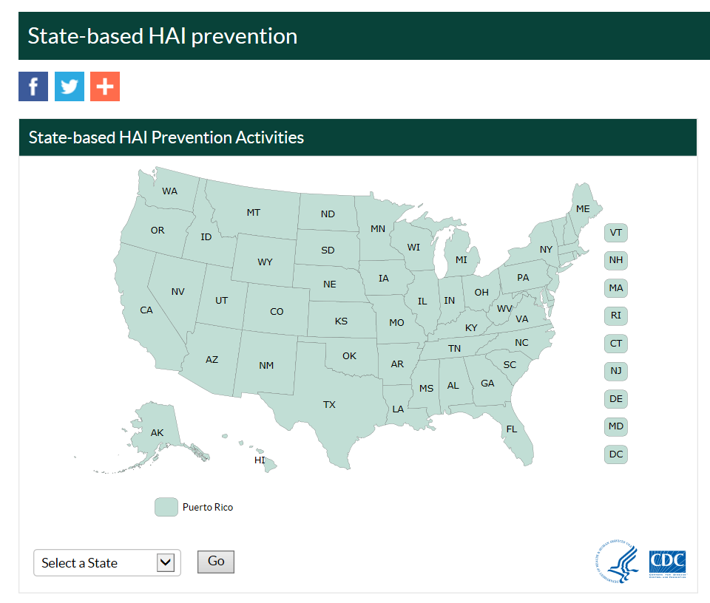
google “cdc hai state”
Click on your state
→ contact info for your HAI/AR Program Manager

Slide 39
Get to know your HAI Program better
  Regular meetings or calls
  Ask to join their HAI-AR Steering Group
  Ask if they have an annual meeting
  Explore training opportunities that could be shared among your respective staff members
  Find out if they are performing on-site “ICAR” QI visits
  Discuss protocols for exchanging information about outbreaks or breaches between your programs
  Compare notes on QI partners you have in common such as Long Term Care provider associations
  Remind them to refer to you as a prevention partner rather than the “bad guy”

Slide 40

Some Closing Thoughts
Strong partnerships between public health and regulatory programs is essential
  Creates new lines of communication
  Strengthens resources for new programs
  Promotes engagement with providers
  Provides feedback for ongoing needs in different settings and identifies “gaps and challenges”
  Improves quality of care delivered at the bedside

Slide 41
THANK YOU!
AFHSA Annual Conference
August 22, 2017
jperz@cdc.gov
Daniel.Schwartz2@cms.hhs.gov

