Slide 4
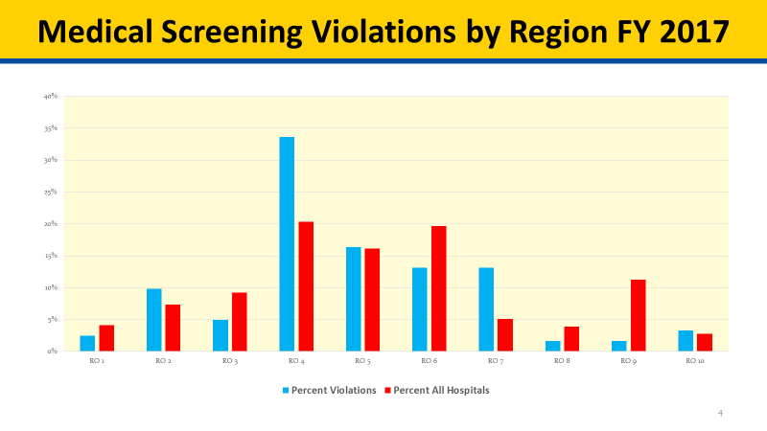

Slide 5
THE OREGON EMTALA EXPERIENCE
September 25, 2018
Karyn Thrapp, RN, BSN – Patient Safety Surveyor
Dana Selover, MD, MPH – HCRQI Section Manager
Public Health Division

Slide 6
Oregon EMTALA by the Numbers
 | FFY 2014 | FFY 2015 | FFY 2016 | FFY 2017 | FFY 2018
Investigations Conducted | 4 | 7 | 10 | 5 | 8
# of Hospitals with Investigations | 4 | 5 | 9 | 5 | 8
Original Allegation Substantiated | 3 | 6 | 8 | 3 | 7
# of Investigations with Violations | 3 | 6 | 8 | 3 | 7
No Violations identified | 1 | 1 | 2 | 2 | 1

Slide 7
EMTALA CITATIONS | FFY 2014 | FFY 2015 | FFY 2016 | FFY 2017 | FFY 2018 | % of Violations
Tag 2400 – Policies & Procedures | 3 | 6 | 7 | 4 | 7 | 79%
Tag 2402 – Posting of Signs | 1 | 1 | 5 | 2 | 5 | 41%
Tag 2404 – On Call Physician |  |  | 2 |  | 1 | 9%
Tag 2405 – Central Log | 2 | 4 | 4 | 2 | 2 | 41%
Tag 2406 – MSE | 2 | 4 | 3 | 1 | 4 | 41%
Tag 2407 – Stabilizing Treatment |  |  | 1 |  |  | 3%
Tag 2409 – Appropriate Transfer | 3 | 4 | 4 | 4 | 2 | 50%
Tag 2411 – Recipient Hospital Responsibilities |  |  | 1 |  | 1 | 6%

Slide 8
Source of EMTALA Complaints July 2014 – June 2018

Slide 9
EMTALA Complaint Outcomes July 2014 – June 2018

Slide 10
EMTALA Violation Allegations July 2014 – June 2018
Whistleblower Protection
Recipient Hospital Responsibilities
Physician On-Call Responsibilities
Reporting Requirements
Postings
Central Log
Transfers
Screening

Slide 11
Oregon’s EMTALA Complaint Triage
All complaints received involving ED care and services are entered into ACTS and initially evaluated for potential EMTALA violations.
All complaints received specifically alleging an EMTALA violation are evaluated to ensure the information provided does reflect a potential EMTALA violation.
Additional information is often requested from the complainant, the receiving hospital reporter, or the hospital self-reporter to ensure sufficient credible information for decision-making.

Slide 12
Oregon’s EMTALA Complaint Triage
The Survey Manager and CMS RO participate in triage and decision-making.
If no potential EMTALA violation is evident the complaint is evaluated for potential COP non-compliance.
Triage case examples and discussion – Handout
What additional information would be helpful, if any?
How would you evaluate?
Oregon’s evaluations and outcomes.

Slide 13
Oregon’s EMTALA Investigation
Investigation preparation includes development of a well-organized survey needs list specific to the complaint.
Request for video or audio recordings are incorporated into the needs list based on the nature of the allegation and have proven to be an important tool in many cases.

Slide 14
Oregon’s EMTALA Investigation
Case example 1 – Allegation that patient presented to parking lot outside of ED, was not brought into the hospital for an MSE, but was transferred to an ambulance called to the hospital and transported to another hospital.
Surveyor review of video recordings of the ED entrance and parking lot clearly captured the sequence of events to substantiate that the patient was not brought into the hospital, was not seen by the ED physician, and was transported from the hospital.
Surveyor review of audio recordings of EMS dispatch and ambulance personnel communications provided further confirmation to substantiate the allegation.

Slide 15
Oregon’s EMTALA Investigation
Case example 2 – Allegation that patient presented to the hospital for emergency services and was directed by hospital staff to go to another hospital for insurance purposes.
At the onset of the investigation hospital staff reported they were aware of the complaint, had done an investigation that included review of video, could not identify the reported patient, and determined that the event had not occurred.

Slide 16
Oregon’s EMTALA Investigation
Case example 2 continued –
During the investigation, the surveyor reviewed video recordings of all entrances to the hospital, the ED registration desk, and the admitting & information desk. Those videos showed an individual with signs of the reported injury entered the hospital through a non-emergency entrance, presented to the first desk he/she encountered, which was the admitting & information desk, spoke with a hospital volunteer, and subsequently exited the building. The individual in the video was confirmed to be the patient in the complaint.
During the hospital’s review of the video recordings they disregarded the individual that had signs of the reported injury.

Slide 17
Oregon’s EMTALA Investigation
Case example 3 – Allegation that Hospital B with capability and capacity refused to accept a patient in transfer from Hospital A that lacked the necessary capability.
The investigation revealed that the hospital did have both capability and capacity and could have accepted the patient in transfer.
“Call Center” audio recordings of a call between call center staff on behalf of Hospital A’s ED physician and Hospital B’s on-call specialty physician clearly confirmed that the on-call specialty physician refused to accept the patient in transfer.

Slide 18
Oregon’s EMTALA Investigation
Case example 3 continued -
Call Center staff: "Hi, so I have [ED physician] from [Hospital A] who wants to talk to you...about a patient that might need to be transferred over. Do you want any -- "
Hospital B on-call specialty Physician: "Oh, uh is it [Hospital A]?…It's a ED patient?"
Call Center staff: "Over at [Hospital A], yes."
On-call specialty Physician: "Yeah, uh - we don’t - we don't cover [Hospital A] anymore."
Call Center staff: "Oh, you guys don't?"
On-call specialty Physician: "No…Bye."

Slide 19
Oregon’s EMTALA Experience
EMTALA challenges secondary to the mental health needs in our communities.
Increases in self-reporting and reporting by other hospitals.
Within the same health system
Receiving hospital requests for information prior to filing formal complaint reports.
Technical assistance provided with direction to Appendix V
Proactive outreach to educate and prevent violations.
Presentations to Hospital partners
Website

Slide 20
Oregon’s EMTALA Experience
Questions and wrap up.

Slide 21
Survey & Certification Information: www.healthoregon.org/hflc
Anna Davis, JD
Survey & Certification Manager
anna.l.davis@state.or.us
(971) 673-2950
Additional Resources:
Dana Selover, MD, MPH
Section Manager
dana.s.selover@state.or.us
(971) 673-0540
HFLC Information:
General Inquiries
mailbox.hclc@state.or.us
(971) 673-0540

