Slide 1
The Future Is Now:
Health Information Technology’s
Impact on Healthcare
Pamela King, MBA, HIE Outreach Coordinator
Florida Center for Health Information and Transparency
Molly McKinstry, Deputy Secretary
Division of Health Quality Assurance
Notes:
Welcome and introduction

Slide 2
Electronic Health Records
Information
Direct Messaging
Robotic Surgery
Patient Look-Up
Patient Portal
Meaningful Use
Network
Health IT
Technology
Event Notification Service
HL7
Exchange
Data Repository
ICD-10
Telehealth
Data Analytics
Electronic Transactions
Coordinated Care
ADT Feeds
Notes:
Definition of Health IT – Word Cloud
What is health information technology? What do you think of when we say Health IT? If audience doesn’t respond right away – presenters joke about them not willing to interact and/or give examples of some Health IT

Slide 3
Notes:
Technology as a Tool
If you were cutting down a tree today would you use an axe or chainsaw? Technology does not in and of itself improve health care. Just a fact! But those that embrace the available tools can cut down that tree more efficiently, effectively, and safely.
Share an example “story” of how using Health IT improved care to a patient (Nemours patient from CA moved back to FL). Reiterate that Health IT is a tool – it does NOT make a physician a better physician – but it is a tool that will allow for outcomes that cannot be achieved without the assistance of technology.

Slide 4
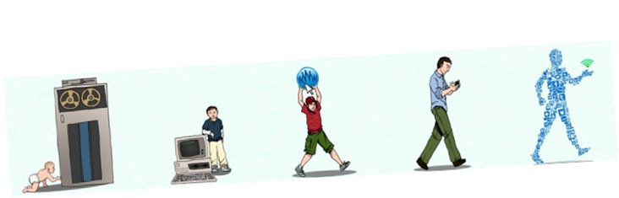
Notes:
Health IT Experience
Every industry has evolved – health care is no different…Health IT has its purposes…And we know because people are using it!
Comparison to Industrial Revolution
Changes in technology in our lifetime…
Data Analytics – story about patient going to ED repeatedly – mention ENS alerting service - physician’s too far away
Patient management – EHR system – capturing medication errors (warfarin story)
Information Access – HIE – share example of HIE use – Prisoner story -
Patient Access – talk a little about telehealth – remote monitoring of patients – mention telehealth survey and TAC.

Slide 5





Notes:
IT vs. Health IT
Talk about how health providers accept technology readily in some forms, but not in others… iPhones, email, Facebook, etc…but less receptive to Health IT….Hospital more accepting – “To Err Is Human – back in 1999”. More recently EHR incentive programs…SNF & HCA slower end of the adoption scale – storm from HCAF conference – Value based care – pushing further adoption…
Just like with other technology health care is a business…and fortunately input by stakeholders - can help to development more effective solution…that will ultimately improve the provider and patient experience

Slide 6

Notes:
ExpectationsS
In health care we are also seeing an evolving expectation from patient about their care and what they expected…Patients expect people that are treating them to have their record – and have it immediately.
Where do you get a stamp story? Or the I have to go into the bank story?
Sense of Community - social media – changing concept of community…
Younger generations…Carrie friends story… Social Media – everyday part of life and it is expected that when those things happen that they will be communicated – they will be shared – instantly.
They have that expectation for their health care providers –that when they move from one provider to another that their records will automatically go with them…
Expectations of physicians fresh out of medical school – physicians, nurses, therapist are all trained to use EHR systems in their training programs now…it is a generational shift…– think about 20 years ago – we did not have email – home computers were just coming out…We are moving into a new era – as a society – and in medicine…

Slide 7

Notes:
Uses for Health IT
Do the “health providers and patients were promised – the Jetsons and we are not quite there yet…but we do have some cool tools…spiel”
Technology is NOT perfect…( We can take turns with the examples of issues)
Health Information Exchange – does the ability to share patient information mean that providers will get all the information you will need – all the time? No – And then sometimes there is so much information it is just too overwhelming
Health It & CIO Rveiw 8/10/2017 - New area of healthcare fraud – eClinical Works settlement – vendor defrauding government and doctors…HHS OIG suit against eClincial Works.

Slide 8




þ
Notes:
State Initiatives
EHR systems – the base for all other health technology – spiel about finding the right EHR system – acknowledge issue with docs having to transition to new systems…Last year to participate in Medicaid EHR incentive program – reiterate that even if they have used EHR for years – they may still qualify.
Building off of the EHR system – talk about communication and sharing information with colleagues … trust, give and take, etc.
DSM for consults – pharmacy communications – etc.
ENS for getting data alerts on patients
PLU for getting patient records
Telehealth – Survey of Providers, Advisory Council…

Slide 9
of physicians believe that the use of an Electronic Health Record (EHR) improves communication between patients
30%
An EHR aided the physician in alerting of:
a potential medication error
65%
critical lab values
62%
essential screening or preventative measures
47%
*http://pxjournal.org/cgi/viewcontent.cgi?article=1071&context=journal
Notes:
1998 … Too Err Is Human…push to get hospitals to adopt EHR systems

Slide 10
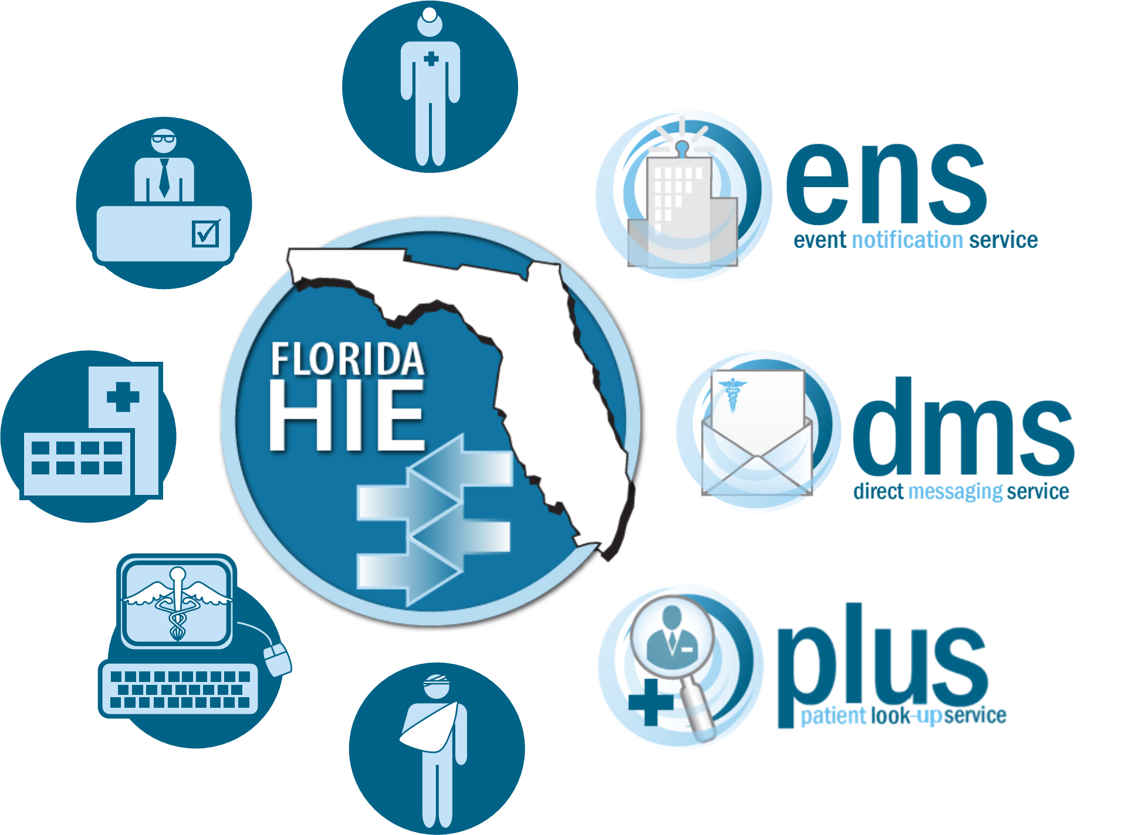
Florida’s Strategy to Promote
Health Information Exchange
Notes:
In Florida…

Slide 11
Current Landscape
Significant Use of Electronic Health Records
Exchange Most Common Within a United Health System
Movement to Exchange across Provider and Levels of Care
Facilitating Opportunities to Improve Communication
Supporting a Variety of Models of Exchange

Slide 12
Event Notification Service (ENS)
Offers timely notice of patient hospital encounters to health care providers and health plans.
  Patient-authorized exchange
  Improves care coordination and transitions of care
  Reduces hospital admissions and readmissions
  Supports value-based payment reform models like ACOs
Participation
  213 hospitals covering over 94% of all acute care hospital beds in Florida
  8 health plans receiving alerts on over 2.7 million Florida residents
  24 ACOs receiving alerts on over 300k Florida residents
  Over 2.2 million hospital encounter alerts delivered since 2015
ENS & MU
  An ENS alert can be the trigger that prompts health care providers to request summary of care records from the discharging hospital in support of MU

Slide 13
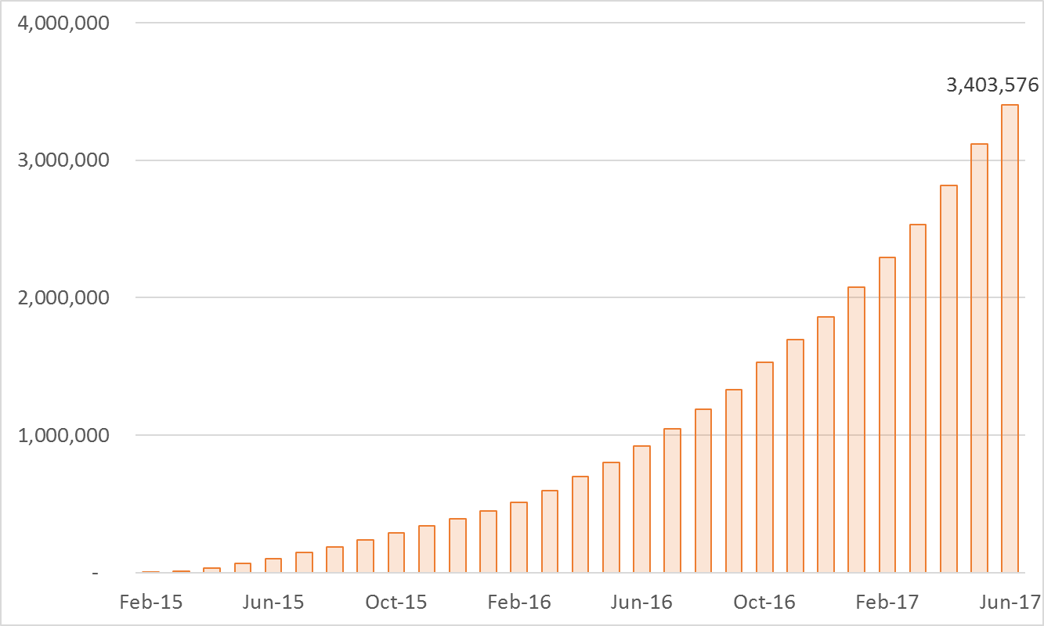
Total ENS Alerts Delivered through June 2017

Slide 14
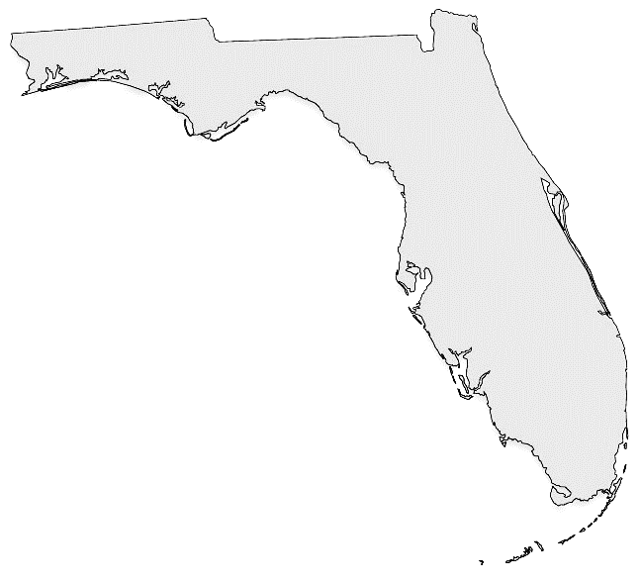
Notes:
In Florida

Slide 15
Timeliness for Telehealth
Physician Workforce Shortage
Expansion of Broadband Connections
Growing Acceptance of Technology
  Physicians
  Patients

Slide 16
Telehealth
HB 7087 (2016) / 2016-240 L.O.F.
Telehealth Advisory Council: 15 members including the Secretary of AHCA (Chair) and the Surgeon General (member)
Survey for current capabilities, utilization and coverage levels:
  AHCA to survey licensed health care facilities
  DOH to survey licensed health care practitioners
  OIR to survey health plans and HMOs
AHCA to submit a report of survey findings to the Governor, Senate President, and Speaker of the House by 12/31/2016
Final Advisory Council report of recommendations to increase the use and accessibility of telehealth services by 10/31/2017
Notes:
House Bill 7087 was passed during the regular 2016 session and became effective 7/1/16
The bill contained 4 primary provisions:
1. Establish the council
2. Conduct a joint survey
3. Compile and submit survey findings to the governor and the legislature
4. Compile and submit council’s recommendations to the governor and the legislature (use survey findings to inform recommendations)

Slide 17
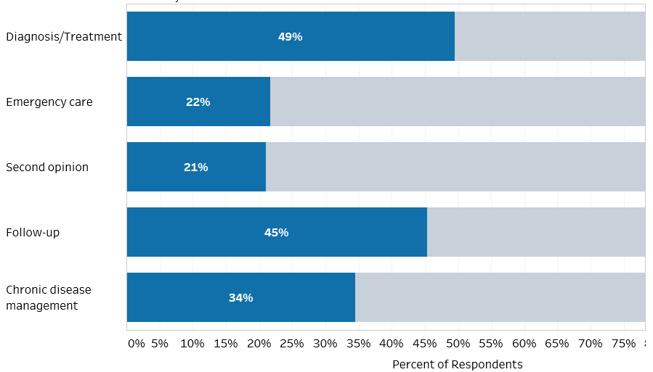
Primary Reported Uses of Telehealth in Health Care Facilities
Notes:
Approximately half of all survey respondents indicated utilizing telehealth to assist with diagnosis and treatment, along with follow-up care.
More than a third are utilizing telehealth to provide ongoing care associated with chronic disease management (remote patient monitoring is a good example of this)
A significant proportion of facilities are also using telehealth for emergency care and second opinions – a good example might be an emergency room at a small rural hospital utilizing telehealth to consult with stroke specialists at a primary stroke center in another city/county.

Slide 18
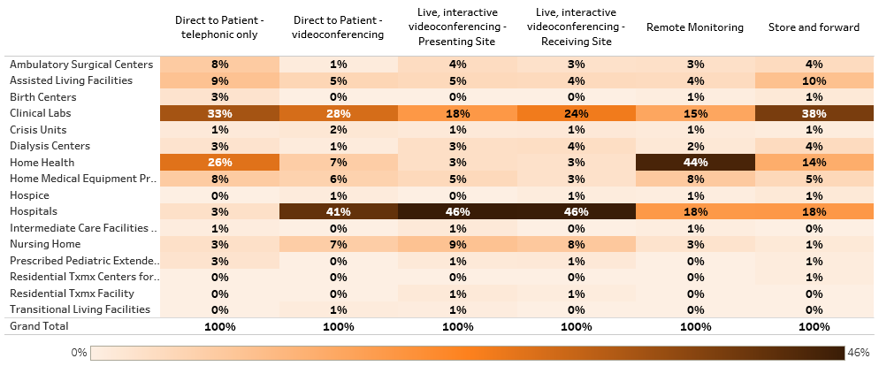
Telehealth Modalities Currently Used, by Facility Type
Notes:
Overall – the highest reported utilizers of telehealth were hospitals (52%), home health agencies, and clinical labs.
The most common modality of Telehealth used among respondents is live interactive video-conferencing, followed by remote patient monitoring.
Video conferencing is most common among hospitals while use of remote monitoring is most prevalent among home health agencies.
More than a third of clinical labs that responded to the survey indicated using store and forward technology

Slide 19
Benefits Reported by Facilities
“What benefits has your facility attained as a result of implementing telehealth services? (Select all that apply)”
Notes:
Note: This was a select all that apply question, so percentages total more than 100%
The greatest benefits realized by providers who are using telehealth is that it improves patient convenience and their ability to provide adequate care coordination to the patient, which in turn improves care outcomes.
One of the most noted improvements in care outcomes is a reduced number of hospital readmissions – as reported by more than a third of providers to answered the survey
Additional notable benefits is that telehealth has expanded access to a wider population and can effectively help to fill gaps when specific services are not readily available in a particular geographical area

Slide 20
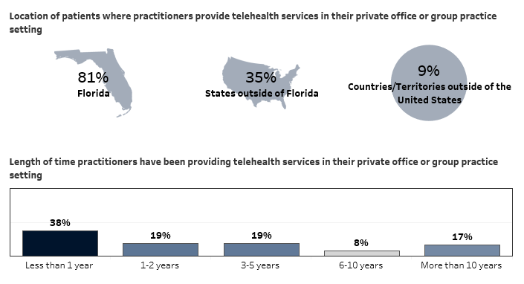
Practitioner Telehealth Use
Notes:
Among Florida licensed practitioners who are using Telehealth:
81% are only providing telehealth services within the state of Florida
35% are providing telehealth services in Florida as well as other states
9% are providing telehealth services in FL and also in other countries
The largest proportion of respondents have been using Telehealth to provide services for less than 1 year, but significant numbers have been providing services using telehealth for longer periods… including nearly 1 out of 5 who indicate they’ve been using telehealth for at least a decade.

Slide 21

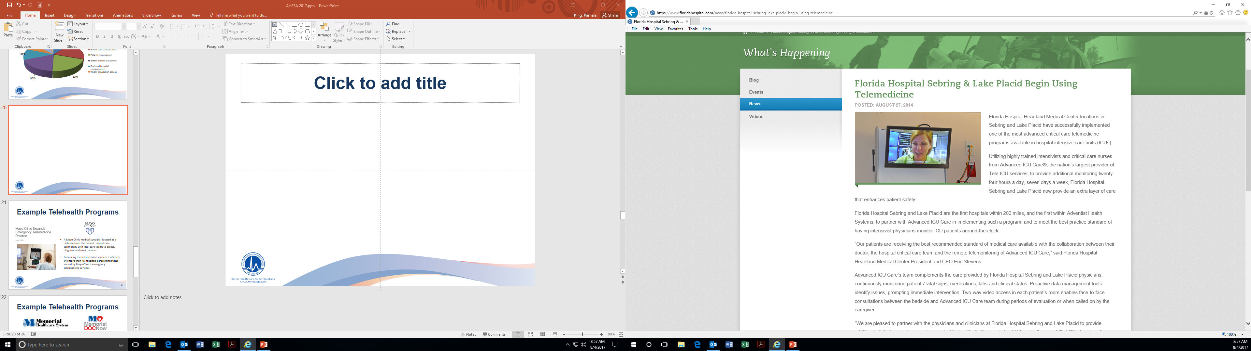
Example Telehealth Programs
Florida Adventist partners with Advanced ICU Care, a provider of Tele-ICU services, to provide 24/7 care
Two-way video access in each patient’s room enables face to face consultations between the bedside and practitioners for evaluations or when call on by a caregiver

Slide 22

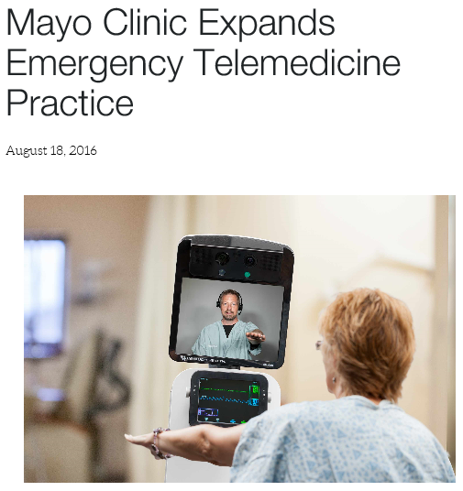
Example Telehealth Programs
A Mayo Clinic medical specialist located at a distance from the patient connects via technology with local care teams to assess, diagnose and treat patients
Enhancing the telemedicine services it offers to the more than 45 hospitals across nine states served by Mayo Clinic’s emergency telemedicine services

Slide 23


Example Telehealth Programs
Memorial Healthcare System unveiled a direct-to-consumer tool in 9/2016
Provides consumers the ability to connect 24/7 with a Memorial doctor and get diagnosed online for non-emergency cases quicker than if the patient was sitting in the emergency room seeking that same level of care
In some cases, the $49 fee to connect with MemorialDocNow may be even more affordable than a co-pay for ER or Urgent Care visits

Slide 24


Example Telehealth Programs
The University of Miami Pediatric Mobile Clinic provides medical care to uninsured children in need - was awarded a $105,000 grant from the Florida Association of Free and Charitable Clinics (FAFCC) via the Florida Department of Health in 2015
The Pediatric Mobile Clinic offers well visits, sports physicals, immunizations, management of chronic conditions, urgent care, mental health and social work
Services were expanded to include store and forward consults - allowing onsite physicians to upload patient information, including images, documents and videos, to a secure web portal where an offsite specialist can later download the information and make diagnoses or treatment recommendations

Slide 25
Telehealth CMP Grant Project
Overview/Purpose:
  Access to specialized care after hours has become an important issue in the quality of care and quality of life of nursing home residents. In-home telemedicine will reduce emergency room visits, hospitalizations, and will provide for a better quality of life for nursing home residents.
  This project will attempt to reduce the frequency of avoidable hospital admissions and readmissions; improve resident health outcomes; and reduce overall health care spending without restricting access to care through telemedicine services.
Notes:
Florida is also taking advantage of Civil Money Penalty funds to benefit Nursing Homes – one of our current CPM grant projects is a study on the benefit of using telehealth in Nursing Homes to reduce hospital transfers. TRECS did a similar study in Maryland with significant results – in paitent satisfaction and financial benefit to the N.H.

Slide 26


Telehealth CMP Grant Project
Project Amount: $275,000
Telemedicine Providers:
  TripleCare
  DocsConnect
Telemedicine services:
  Provided at four Florida nursing homes
  Utilized from 6:00 pm to 7 am EST, Monday through Friday, all day Saturday, Sunday and national holidays

Slide 27
Telehealth Challenges
Payment Parody
Fraud and Exploitation
  Home Care
  Telemarketing – Unsolicited
  Identity Theft/ Patient Broking/ Kickbacks
  Unnecessary/Custom Equipment and Services

Slide 28
Other Florida Health IT Initiatives
FloridaHealthFinder.gov
Price Transparency
Promotion of e-Prescribing

Slide 29
Health IT & Regulation
Reimbursement
  Public Payers
  Private Payers
HIPAA
  Patient Consents
Impact on State Regulatory Duties
  Integrate Technology
  Leverage Analytics
State Requirements Vary Widely
  – Know Yours
Notes:
As regulators we need to evolve --- there are changes and different ways we do have to look at issues –
The main issue I hear about when speaking on Health IT – is fraud. I like to remind people that there is equal opportunity cheating…whether on paper or electronically. With IT there are some safe guards…things to look for – can the MA log in for the doctor? Etc…
Can providers bill for telehealth services? Varies greatly from state to stae
HIPPA --- consent requirements in your state? In Florida specific requirements around Behavioral health

Slide 30
Remember…
  Health IT is a Toolbox
  It is about the Patient!
  The Future is NOW!
Notes:
Health IT Take Away
We have thrown a lot of information at you today… but if you don’t remember anything else remember this… -- Graphic…the words…
Health IT is a toolbox – you need to find the right tools to take out of it
There are opportunities available right now to help you in purchasing the tools you need
It is about the Patient – their experience

Slide 31




Connect with Us:
www.florida-hie.net
flhii@ahca.myflorida.com
www.facebook.com/AHCAFlorida
@AHCA_FL
Notes:
Contact information… slide
Questions?
…if you want more…come see us at our booth… We want share information

