Slide 1
Best Practices for Florida Home-Based Surveyors AHFSA Annual Conference August 6, 2019
Michelle Dillehay RN-BC
Agency for Health Care Administration
Division of Health Quality Assurance

Slide 2
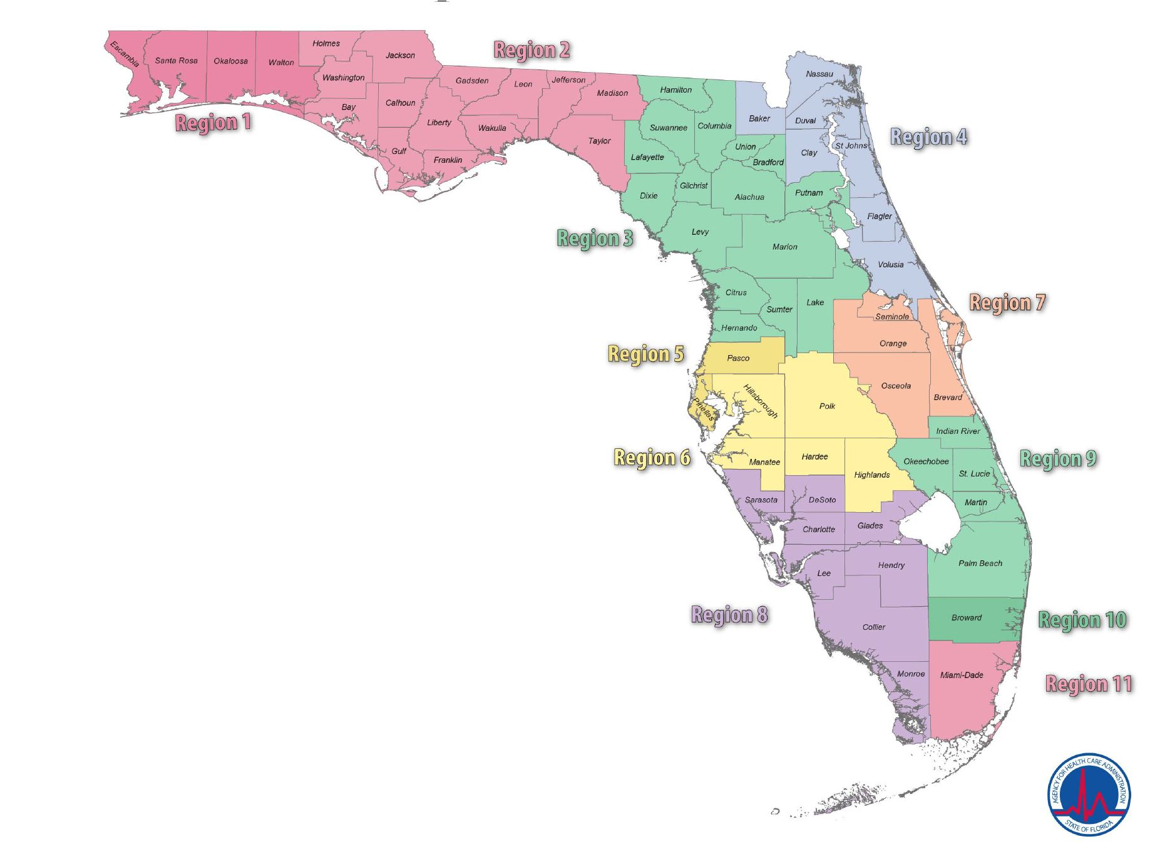
Eight Field Offices in Florida

Slide 3
Florida Facts
284 surveyor positions in Field Operations.
11 areas combined into 8 Field offices.
48,236 Active Providers.
307 Hospitals.
693 Nursing Homes.
3070 Assisted Living Facilities.
1922 Home Health Agencies.

Slide 4
Florida Providers
Nursing Homes - most in Tampa/ St Pete: 162
Nursing Homes - least in Miami: 55
Hospital – most in Tampa/ St Pete: 57
Hospital – least in Ft Myers: 28
ALF - most Miami: 827
ALF - least Tallahassee/Pensacola: 107
HHA - most in West Palm/Fort Lauderdale: 519
HHA - least in Tallahassee/ Pensacola: 84

Slide 5
Remote Worker
An individual who has a voluntary work arrangement and is allowed to perform the normal duties and responsibilities of the position through the use of Agency issued technology (such as table computers and smart phones) at an approved remote work location.

Slide 6
Remote Worker (cont.)
Home office provides workspace that is free of safety and fire hazards.
Employer is not liable for damages to employees property resulting from participation as a remote worker.
Employees will not be allowed to continue in the Remote Worker program while on a Corrective Action Plan.

Slide 7
Remote Worker (cont.)
Employee will apply safeguards to protect records and state equipment from unauthorized use, disclosure, or damage.
Employees must use only Agency issued, encrypted computers/devices to conduct Agency business involving personal health information (PHI) and other confidential information.

Slide 8
Remote Worker Agreement
Duration
Work Hours
Leave
Overtime
Cost
Liability
Workers’ Compensation
Home Safety
Work Assignments
Evaluation
Records

Slide 9
Remote Worker Agreement (cont.)
If employed less than 30 days, a training plan must be attached to the agreement.
Employee may elect to stop participating in the program at any time.
Employee agrees to report to the Field Office at the request of the Field Office Manager or Supervisor.

Slide 10
Remote Worker Agreement (cont.)
Management has the right to remove the employee from the program at any time if, within management’s sole discretion, continued participation would not be in the Agency’s best interests.

Slide 11
Remote Worker Status
Varies -upon hire to 2-4 weeks after hire date.
Distance of home office from Field Office varies.
Each Field Office varies in geographic area, number of counties, and number/type of facilities.
Surveyors might “Practice Remote.”

Slide 12
Remote Worker Status (cont.)
Work at home versus driving into the Field office on the scheduled “office day.”
Travel Reimbursement - Claim time and mileage from own driveway.
All surveyors come into office every month or every other month for staff meeting/in-service and computer updates.

Slide 13
Remote Worker Communication
iPhone
Surface Pro
Timeframes for communication are in the performance expectations.
Skype
Conference calls.

Slide 14
Remote Worker Communication (cont.)
Electronic survey forms emailed to Field Office.
Electronic copies of records via Cam Scan.
Paper copies sent to office via FedEx or sent with another surveyor traveling to the Field Office.
Timesheets and travel reimbursement vouchers online.

Slide 15
Remote Worker Tips
Assess computer skills during interview and ask what qualities are necessary to be an effective remote worker.
Have surface pro and iPhone ready on day of hire.
“Practice” remote prior to signing agreement.

Slide 16
Remote Worker Tips (cont.)
Discuss common barriers to working from home. (HIPAA, WiFi, cell phone service, distractions).
Where to find resources – Intranet, Shared drive, AHCA Portal, Travel System and People First.

Slide 17
Remote Worker Tips (cont.)
Be clear about expectation to contact IT Helpdesk, Distributed Computer Systems Analyst, and/or drive to the office for any technical issues that are not easily resolved.
Remote status can be revoked, but most surveyors resume remote status after coaching.

Slide 18
Remote Worker Tips (cont.)
Week-long Face-to-Face training sessions several times throughout the first 6-8 months.
Coaching Program.
Retention Committee – we want you to stay!
Consistent and frequent follow up from Supervisor.

Slide 19
Remote Worker Tips (cont.)
Awareness of performance expectations.
Awareness of accounting of time.
Advertise remote worker as a benefit.

Slide 20
Thank You
Michelle Dillehay
Registered Nursing Consultant
Florida Agency for Health Care Administration
Bureau of Field Operations
Survey and Certification Support Branch
407-413-0621
Michelle.Dillehay@ahca.myflorida.com

