Slide 1
iQIES Home Page

Slide 2
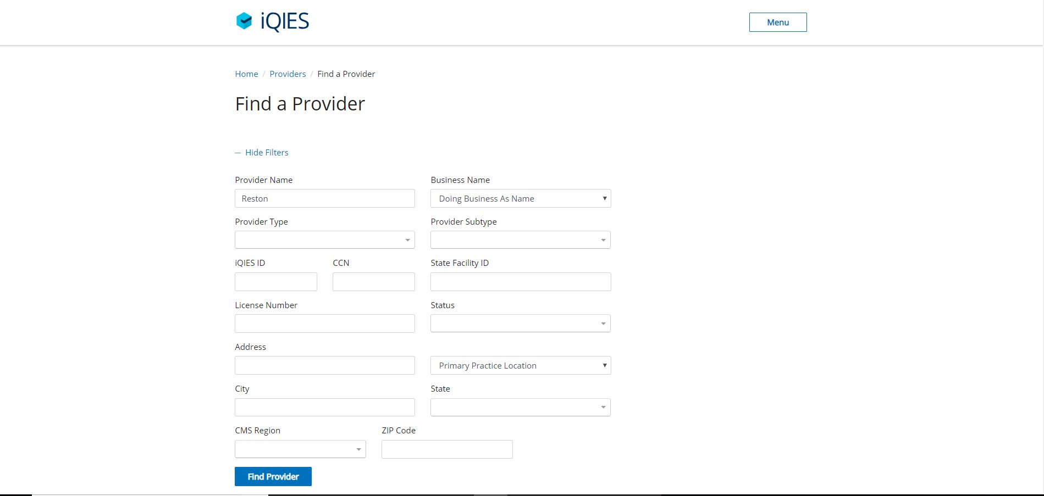
iQIES- Find a Provider

Slide 3
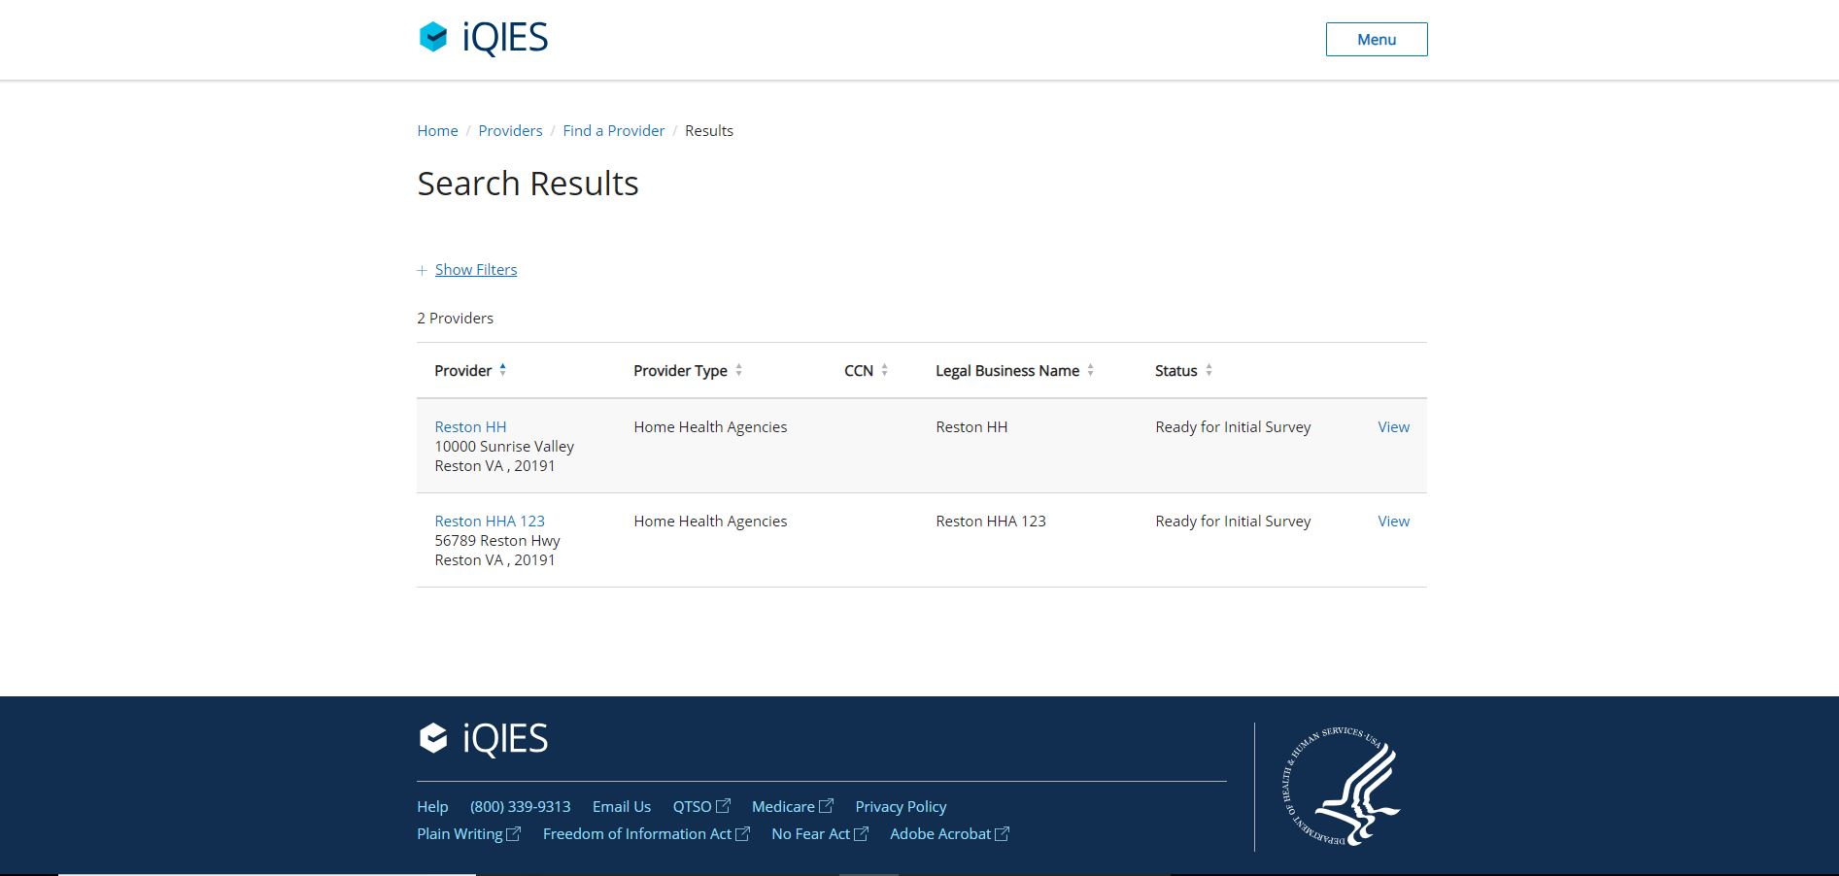
iQIES – Provider Search Results

Slide 4
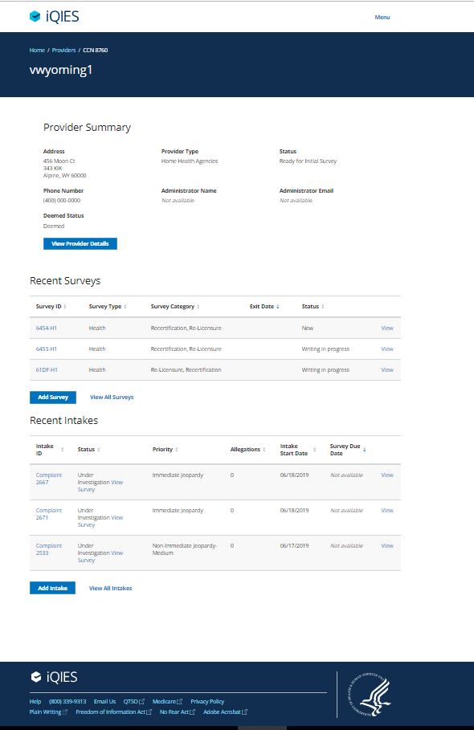
iQIES-Provider Profile

Slide 5
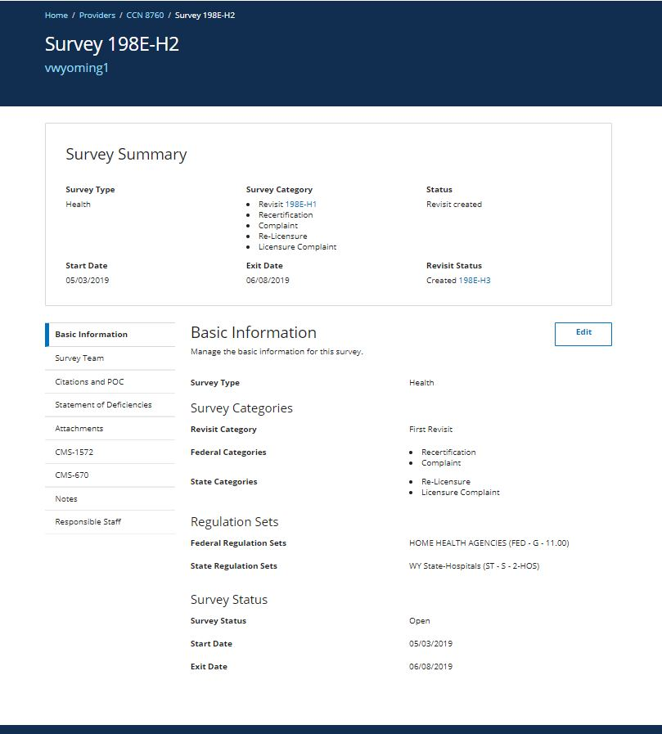
iQIES – Survey Details

Slide 6
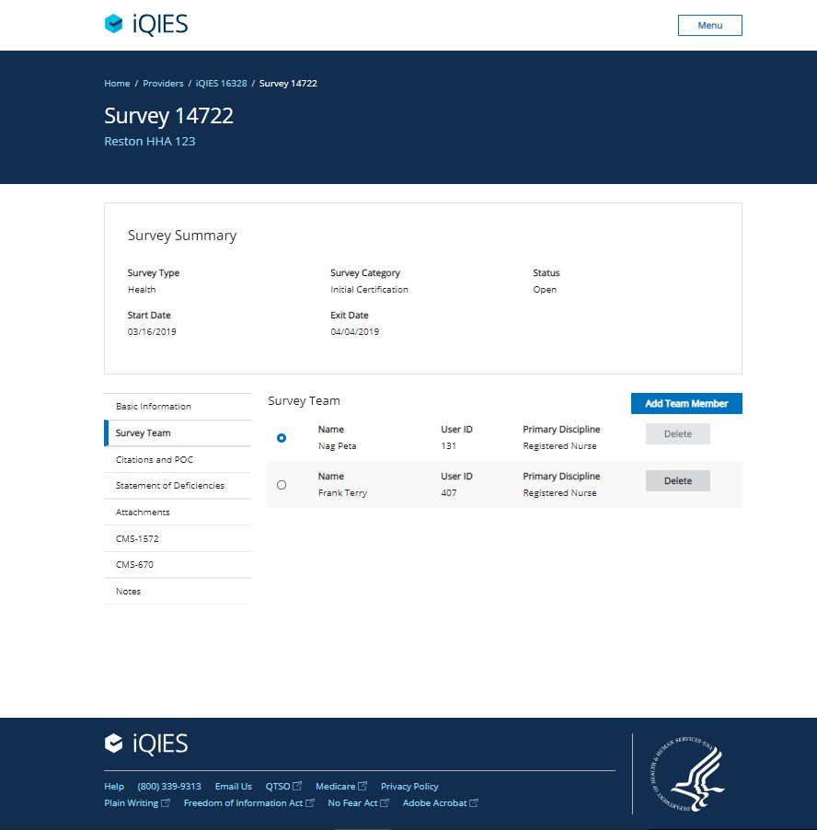
iQIES – Survey Team Management

Slide 7
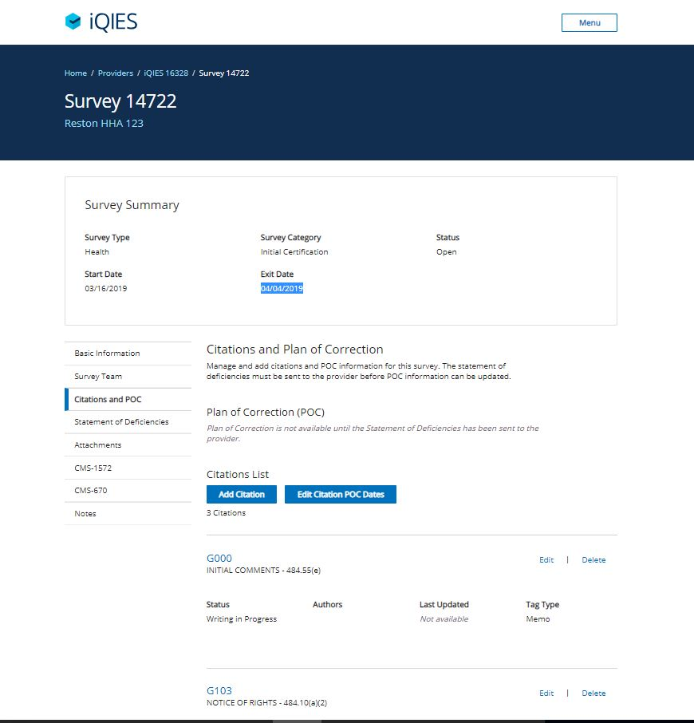
iQIES – Survey Citation Management

Slide 8
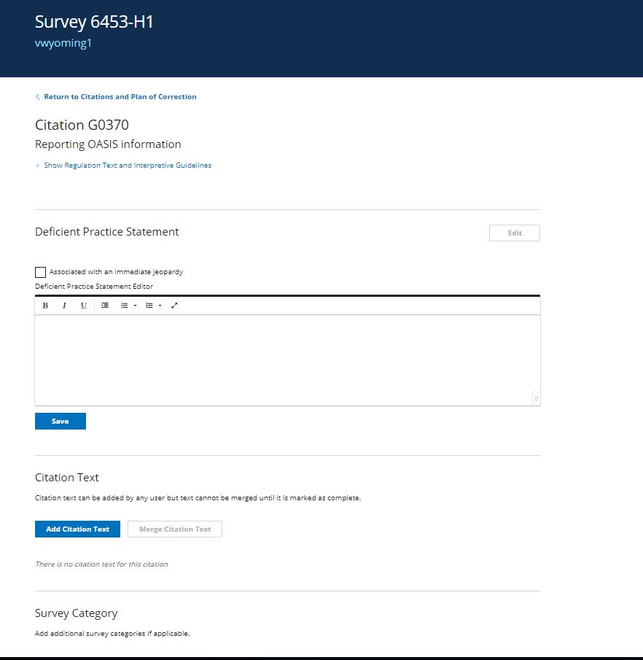
iQIES – Survey Citation Management

Slide 9
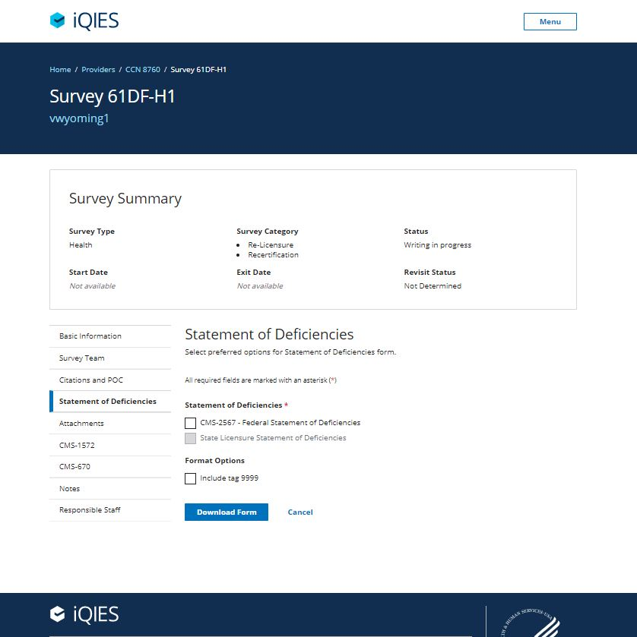
iQIES – Statement Of Deficiencies

Slide 10
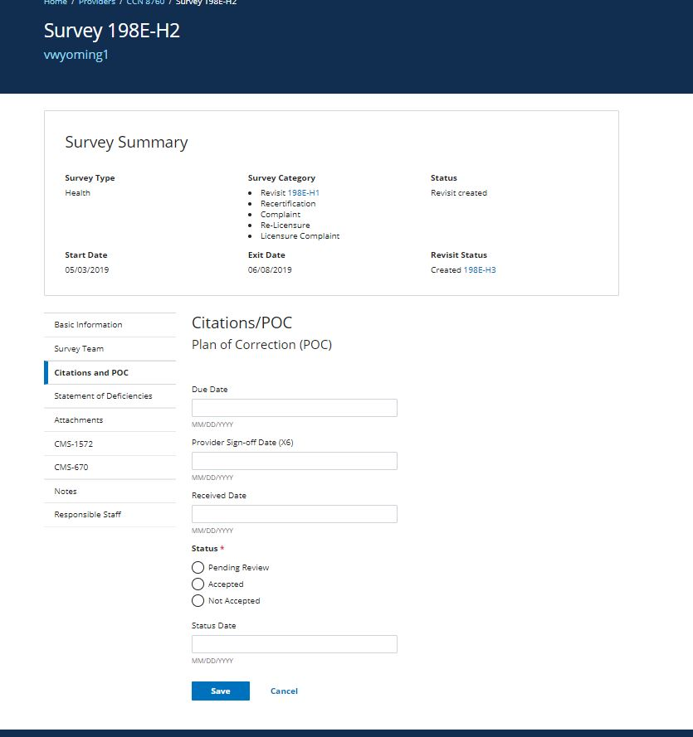
iQIES – Plan of Correction Tracking

Slide 11
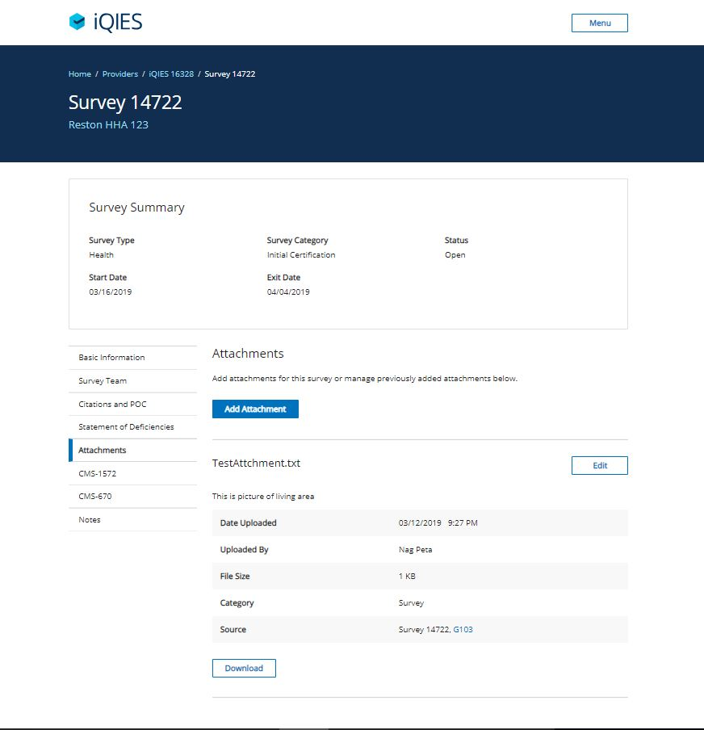
iQIES – Survey Attachments

Slide 12
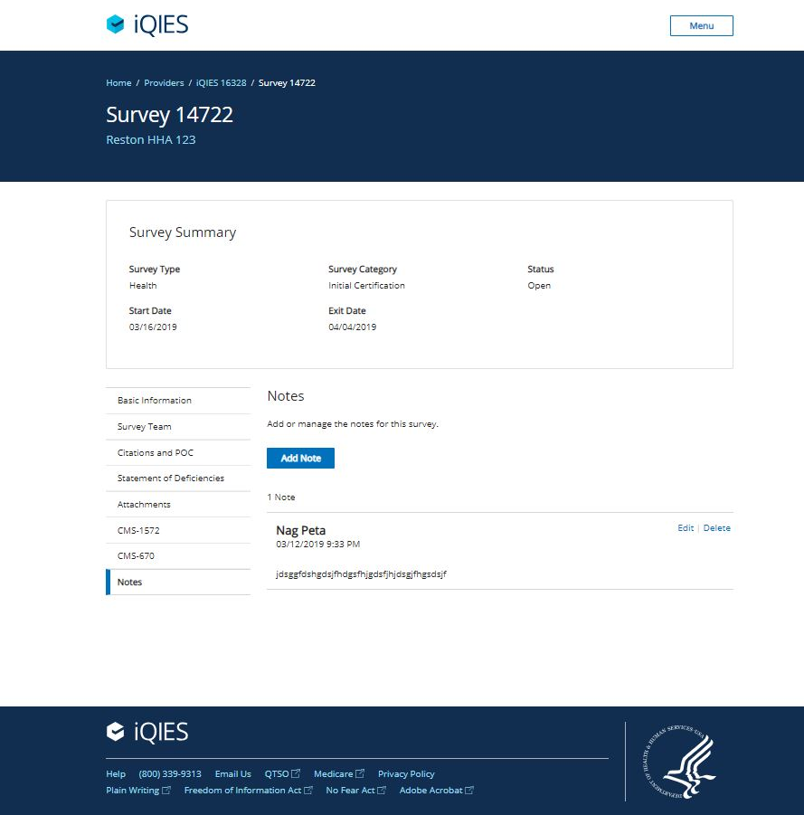
iQIES – Survey Notes

Slide 13
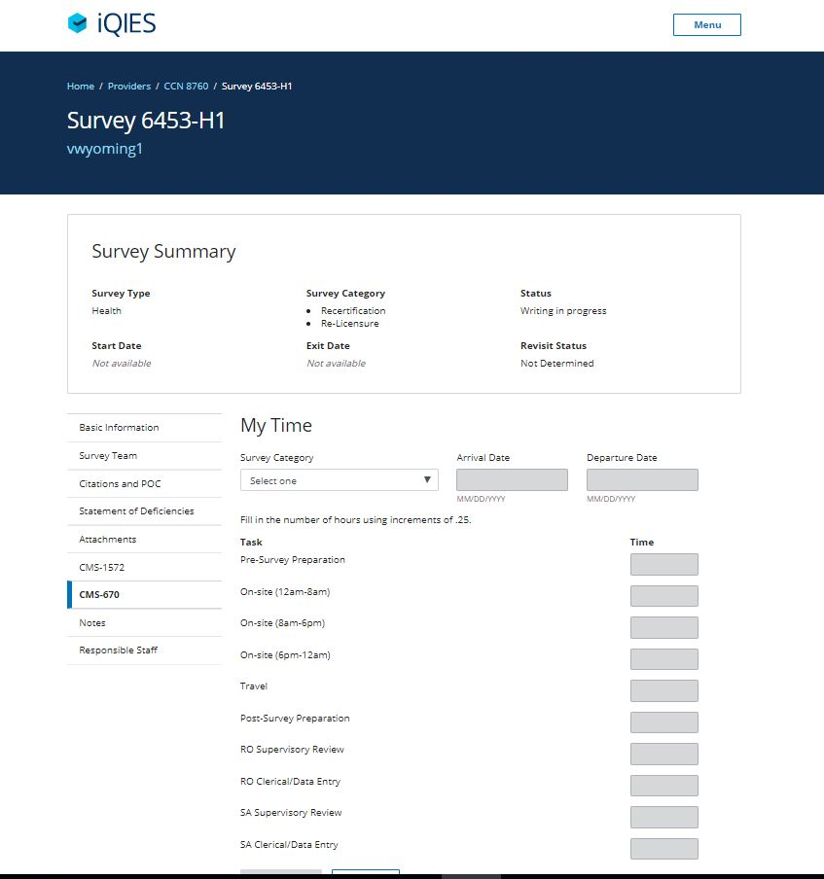
iQIES – Survey Time Tracking

Slide 14
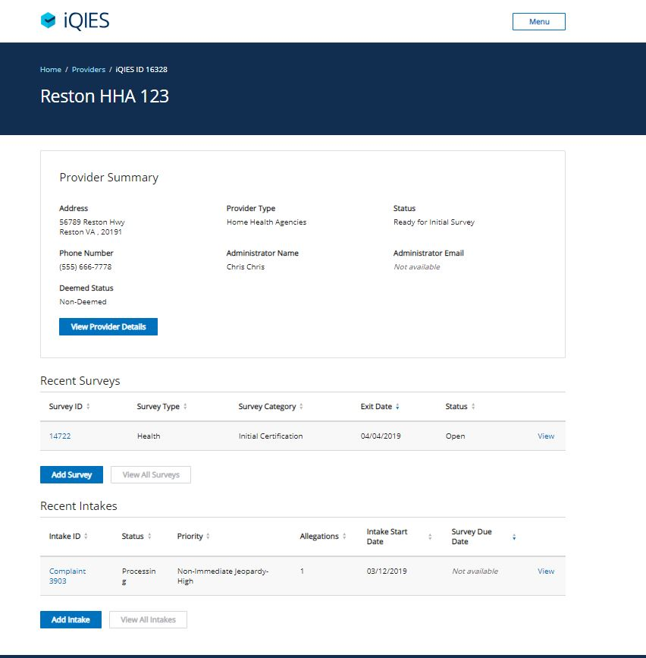
iQIES – Provider Profile

Slide 15
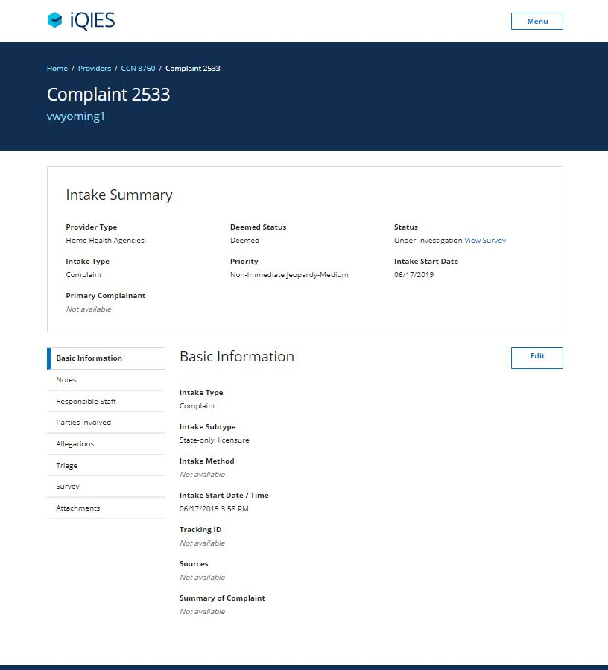
iQIES – Complaints Intake

Slide 16
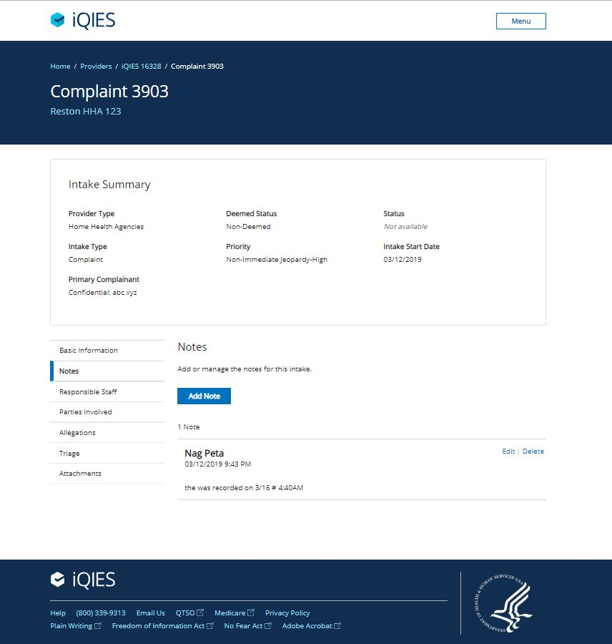
iQIES – Complaints Intake- Notes

Slide 17
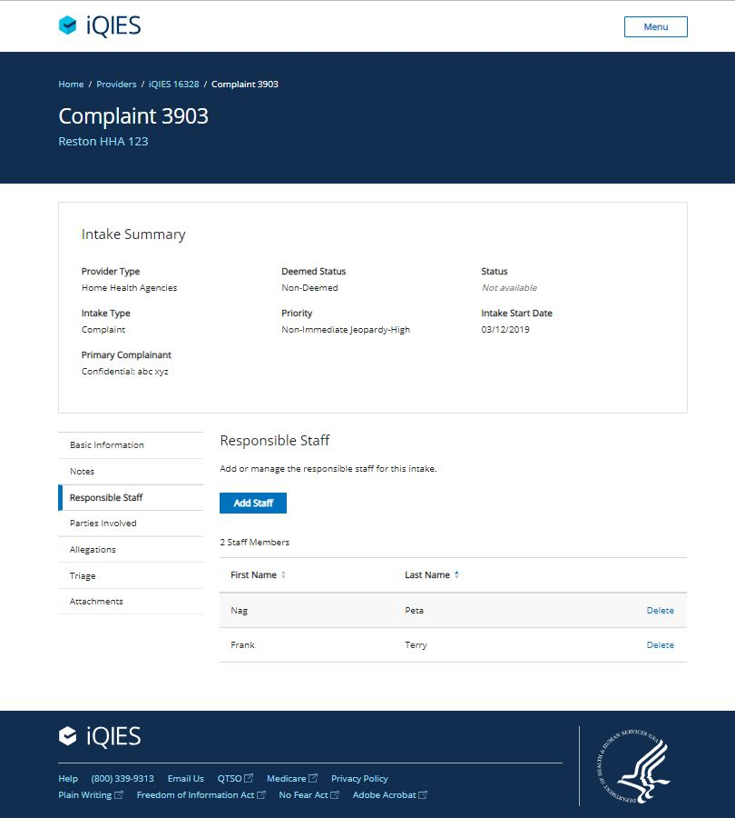
iQIES – Complaints Intake –Resp Staff

Slide 18
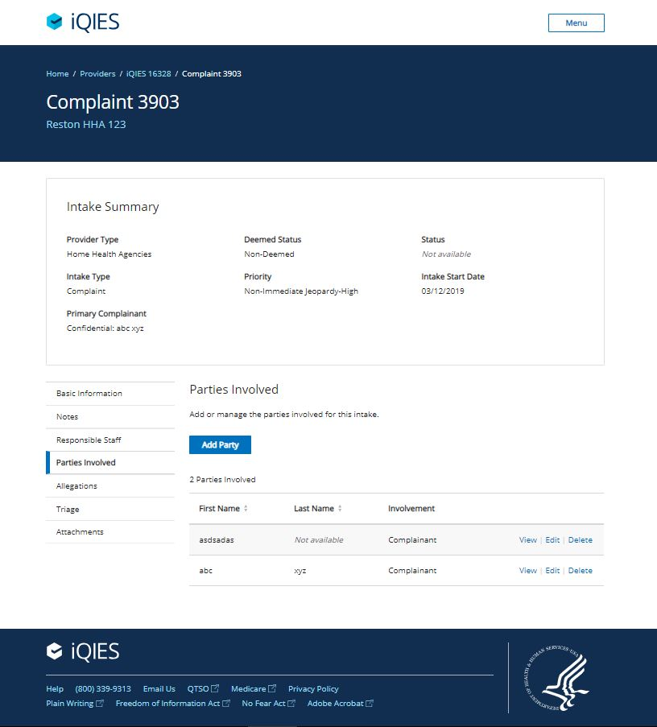
iQIES – Complaints Intake –Parties Involved

Slide 19
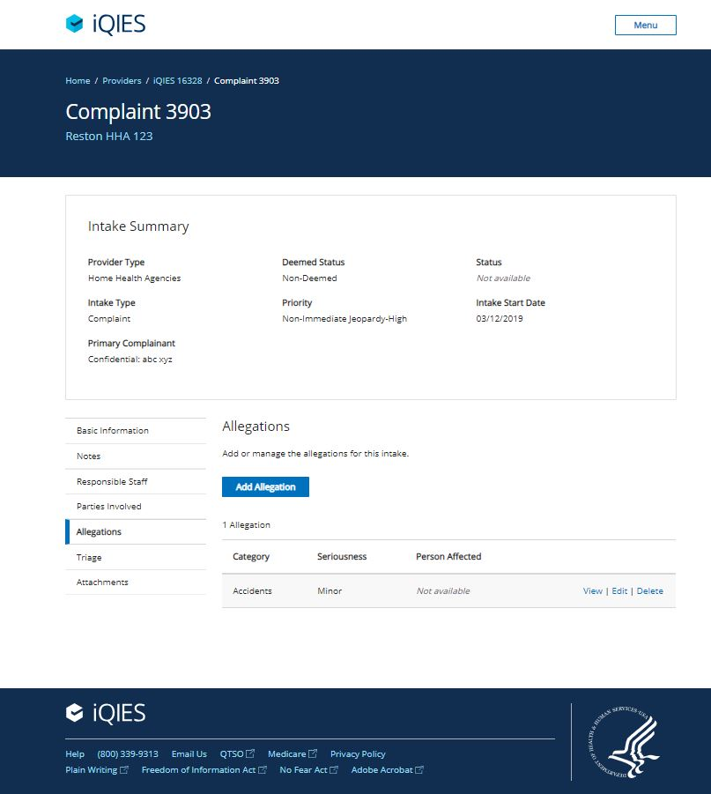
iQIES – Complaints Intake - Allegations

Slide 20
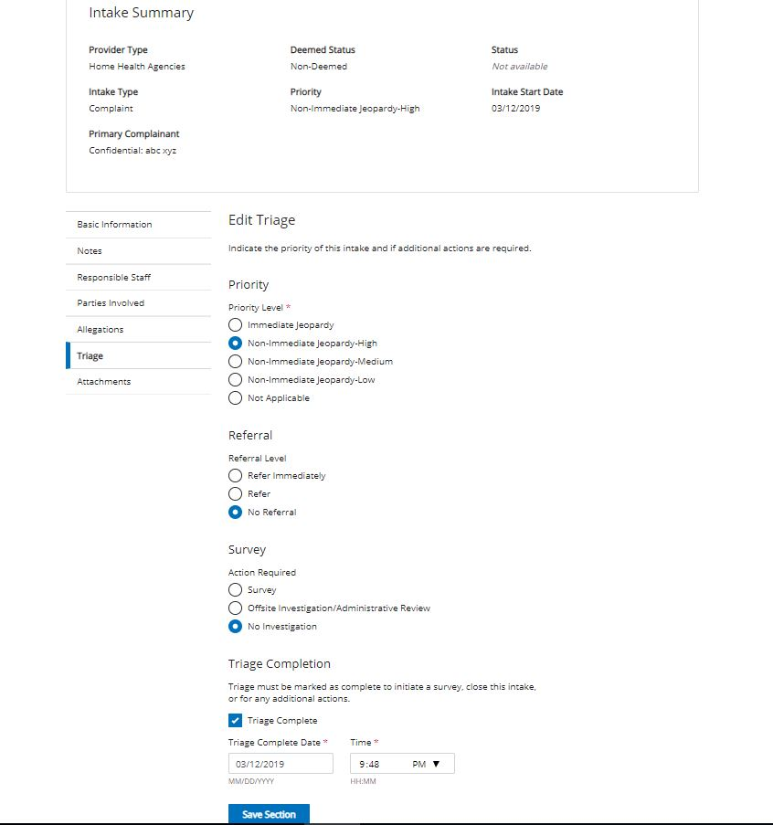
iQIES – Complaints Intake - Triage

Slide 21
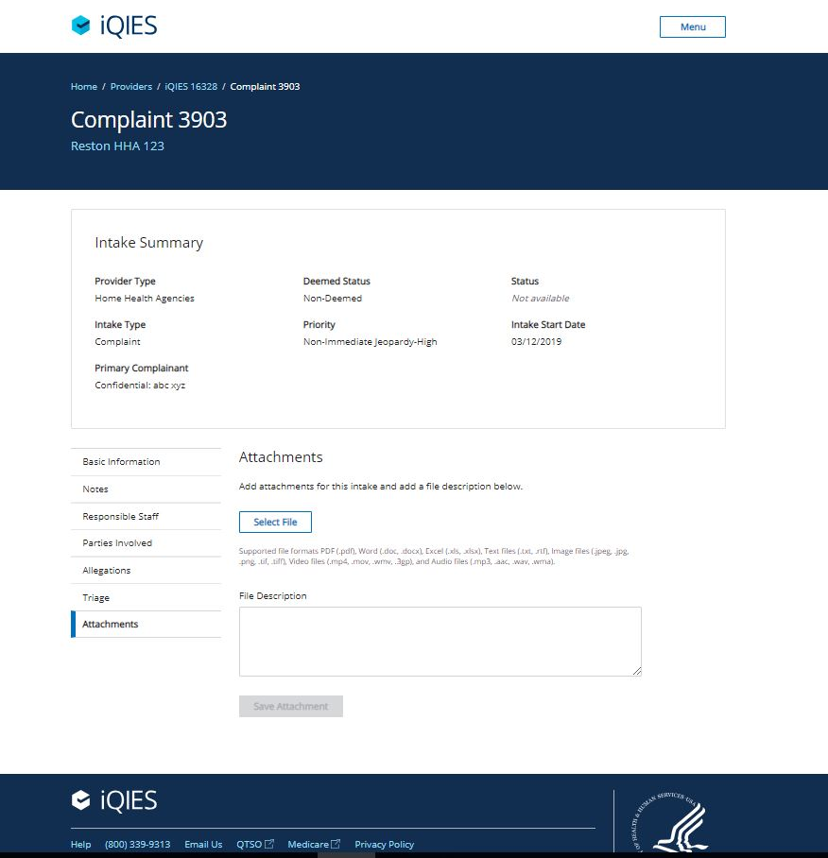
iQIES – Complaints Intake - Attachments

Slide 22
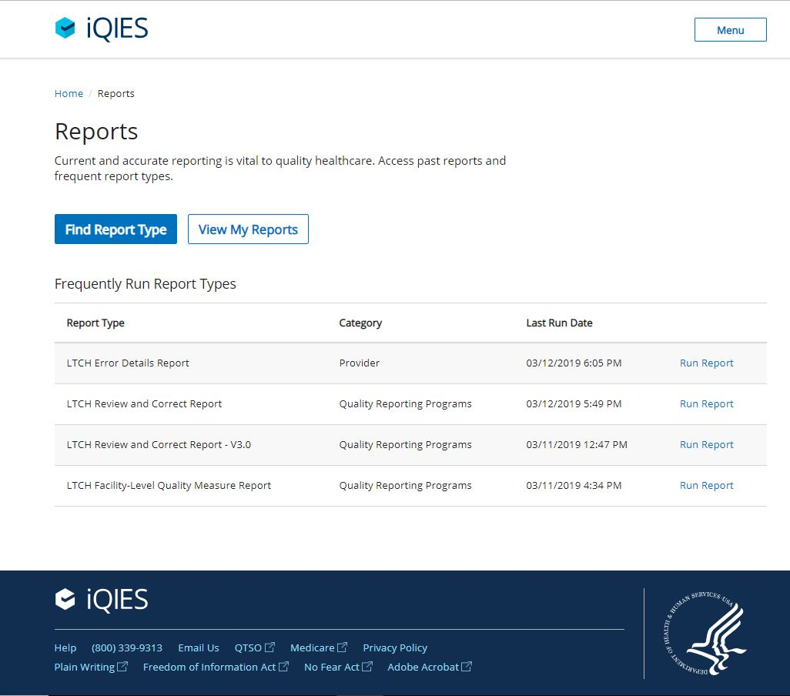
iQIES – Reports Landing page

Slide 23
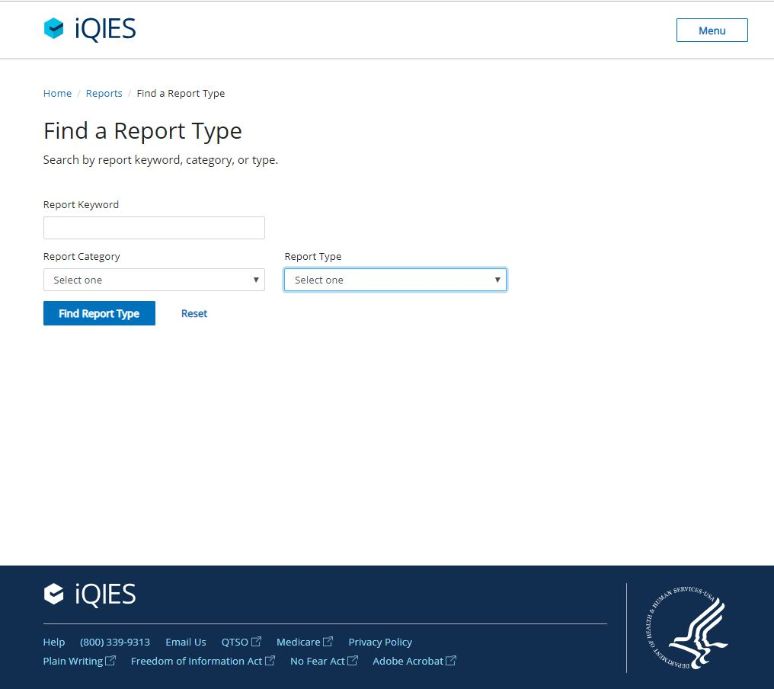
iQIES – Find Report

Slide 24
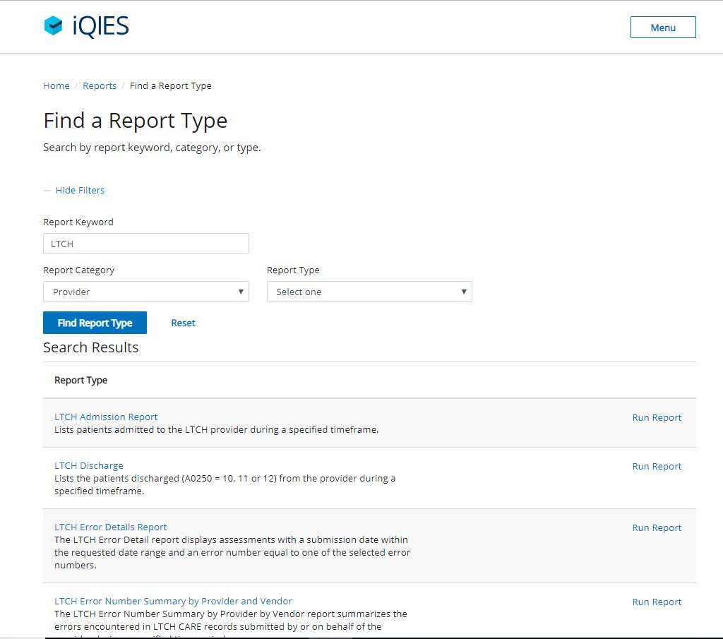
iQIES – Find Report Type

Slide 25
iQIES Demo

Slide 26
Questions

