Slide 1
MICHIGAN TIERED EXCLUSIONS
AHFSA Annual Conference
Background Screening Interest Track
August 4-7, 2019
Adam Krajniak, Manager
Michigan Department of Licensing and Regulatory Affairs, Bureau of Community and Health Systems
Workforce Background Check Unit

Slide 2
Objective: To learn about Michigan’s Workforce Background Check Program, and the Pros and Cons of a Tiered Exclusionary System.
Questions from interested States: Our conference goal is dialog. In this session, representatives from interested States are encouraged to ask questions; describe their challenges of effectiveness, efficiency and equity; and exchange information.

Slide 3
EFFECTIVE APRIL 1, 2006
MCL 333.20173a (Public Health Code)
MCL 330.1134a (Mental Health Code)
MCL 400.734b (Adult Foster Care Licensing Act)
Nursing Homes
County Medical Care Facilities
Hospices
Hospitals with Swing Bed Services
Certified Home Health Agencies
Psychiatric Hospitals/Inpatient Units
Homes for the Aged
Adult Foster Care Facilities
Staffing/Contract Agencies (verified)

Slide 4
Who Is Included?
THE BACKGROUND CHECK LAWS REQUIRE COVERED PROVIDERS TO CONDUCT A FINGERPRINT-BASED BACKGROUND CHECK ON PERSONS THEY ARE:
EMPLOYING
INDEPENDENTLY CONTRACTING WITH
GRANTING CLINICAL PRIVILEGES TO
… WHO REGULARLY HAVE DIRECT ACCESS OR PROVIDE DIRECT SERVICES TO PATIENTS OR RESIDENTS OF THE COVERED FACILITY/AGENCY
“Direct Access” means, “… access to a patient or resident or to a patient’s or resident’s property, financial information, medical records, treatment information, or any other identifying information.”

Slide 5
WHAT IS INCLUDED?
STATE AND FBI FINGERPRINT-BASED CHECK
TIERED EXCLUSION SYSTEM FOR RELEVANT CONVICTIONS
1 YEAR TO PERMANENT DEPENDING UPON AGE, OFFENSE OF CONVICTION/SEVERITY
ALSO EXCLUDES FOR:
ANY FINDING OF NOT GUILTY BY REASON OF INSANITY (NGRI)
SUBSTANTIATED FINDINGS OF ABUSE, NEGLECT, OR MISAPPROPRIATION OF PROPERTY
RELEVANT FINDINGS ON REGISTRY CHECKS
Office of Inspector General (OIG)
Michigan Sanctioned Provider List (SPL)
Michigan Nurse Aide Abuse Registry (NAR)
Michigan Public Sex Offender Registry (PSOR)
Michigan Department of Corrections Offender Tracking Information System (OTIS)

Slide 6
RAPBACKS
REQUIREMENT OF THE BACKGROUND CHECK LAWS
PROVIDES FOR CONTINUOUS MONITORING OF WORKFORCE (ONLY STATE OF MI THUS FAR, FBI EVENTUALLY…)
THE WORKFORCE BACKGROUND CHECK UNIT NOTIFIES EMPLOYERS OF INELIGIBILITY IF ANY EXCLUSIONARY CONVICTION IS RECEIVED VIA RAPBACK
ARREST/CHARGE IS NOT CAUSE FOR TERMINATION

Slide 7
CONVICTIONS
THE LAWS DEFINE CONVICTION AS: “… a final conviction, the payment of a fine, a plea of guilty or nolo contendere if accepted by the court, or a finding of guilt for a criminal law violation or a juvenile adjudication or disposition by the juvenile division of probate court or family division of circuit court for a violation that if committed by an adult would be a crime… For a relevant crime described under 42 USC 1320a-7(a), convicted means that term as defined in 42 USC 1320a-7.”
This definition includes alternative sentencing agreements (unless non-public) until dismissed or made non-public by the court.
For relevant crimes under 42 USC 1320a-7, the definition also includes cases which have been dismissed upon completion of alternative sentences, or in cases of formal convictions, which have been expunged or set aside.

Slide 8
TIMEFRAMES
PERMANENT EXCLUSION FOR MANDATORY CRIME UNDER 42 USC 1320A-7
15 YEAR EXCLUSION (FOLLOWING COMPLETION OF SENTENCE) FOR A FELONY, OR ATTEMPT OR CONSPIRACY TO COMMIT A FELONY, INVOLVING THE USE/THREAT OF FORCE OR VIOLENCE
10 YEAR EXCLUSION (FOLLOWING COMPLETION OF SENTENCE) FOR ANY OTHER FELONY, OR ATTEMPT OR CONSPIRACY TO COMMIT ANY OTHER FELONY
3 – 10 YEAR EXCLUSION (FOLLOWING DATE OF CONVICTION) FOR ANY MISDEMEANOR INVOLVING ABUSE, NEGLECT, CSC, CRUELTY, ASSAULT, FRAUD, THEFT, SHOPLIFTING, HOME INVASION, EMBEZZLEMENT, CONTROLLED SUBSTANCE
1 YEAR EXCLUSION (FOLLOWING DATE OF CONVICTION) FOR MISDEMEANOR DRUG OFFENSES IF UNDER AGE 18, MISDEMEANOR THEFT/SHOPLIFTING IF UNDER 16
CONTAINED IN SECTION (1) OF BACKGROUND CHECK LAWS

Slide 9
REDETERMINATIONS
LAWS ALLOW REDETERMINATION (APPEAL) BASED ONLY UPON INACCURACY OF RECORD OR CONVICTION BEING EXPUNGED/SET ASIDE
30 DAY RESPONSE TIME PER LAWS
DECISION OF DIRECTOR IS FINAL
REDETERMINATIONS – INFORMAL (WITHIN UNIT)
VAST MAJORITY, >90% PROCESSED WITHIN 1 BUSINESS DAY
APPEAL - FORMAL (ADMINISTRATIVE HEARING)
<10 IN HISTORY OF PROGRAM

Slide 10
PROS
CONSISTENCY
AVOIDS BIAS OR PERCEIVED BIAS
EASY TO LEARN/REFERENCE
EASY FOR APPLICANTS, EMPLOYERS, SCHOOLS TO KNOW IN ADVANCE IF APPLICANT WILL BE ELIGIBLE FOR EMPLOYMENT
EFFICIENCY
TURNAROUND TIME
REDETERMINATION RESPONSE TIME (SANITIZING CHRI UPFRONT)
MAXIMIZING AVAILABLE TECHNOLOGY
REDUCED STAFFING REQUIREMENTS
BUDGET

Slide 11
SINCE 4/1/06 (as of 7/17/19)
Total number of fingerprints taken: 1.29 million
Initial exclusions (analyst): 15,721
Rapback exclusions (analyst): 14,318
Registry Check exclusions (providers): 14,098
Redeterminations/Appeals received: 3,161
Granted: 1,837
Denied: 1,324
(does not include Registry Check exclusions)

Slide 12
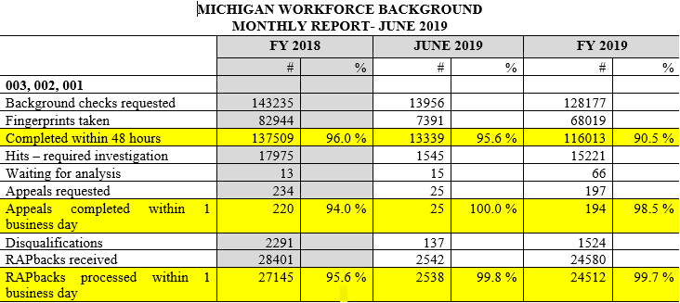
FY 2018/2019

Slide 13
CONS
NO DISCRETION
DOES NOT TAKE INTO ACCOUNT…
CIRCUMSTANCES OF OFFENSE
YOUTHFUL INDESCRETION, MATURATION
LIFE CIRCUMSTANCES
REHABILITATION
PATTERN OF CONCERNING BEHAVIOR
COURT/JUDICIAL JUDGMENT…
…. OVERCHARGING & PLEA AGREEMENTS
INADEQUATE LEGAL REPRESENTATION
CHANGES TO OTHER LAWS (EG, RECREATIONAL MARIJUANA)
MONITORING/SANCTIONING PROGRAMS (AG, LICENSING)
OTHER RESOURCES EXPENDED (MDOC, SKILLS TRAINING)
HARD TO DETERMINE EFFICACY OF THE LAWS

Slide 14
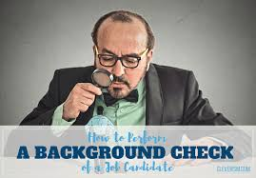
Questions from States?

